Slide 1
Return to Work: The Most Important Issue You’ve Completely Overlooked

Slide 2
Return to Work: Trust in You as the Boss

Slide 3
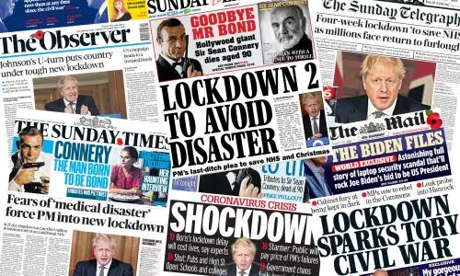

Slide 4
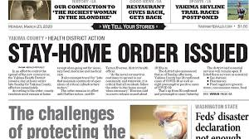

Slide 5
Business
Continuity
Plan + Train
WFH

Slide 6
“They’ll Be Fine”
WFH

Slide 7
WFH
“What Could Go Wrong?”

Slide 8
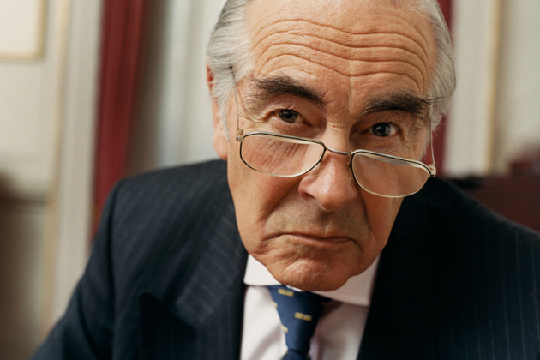
WFH
“Send ‘em Home. Simple!”

Slide 9
Business
Continuity
Plan + Train
WFH

Slide 10
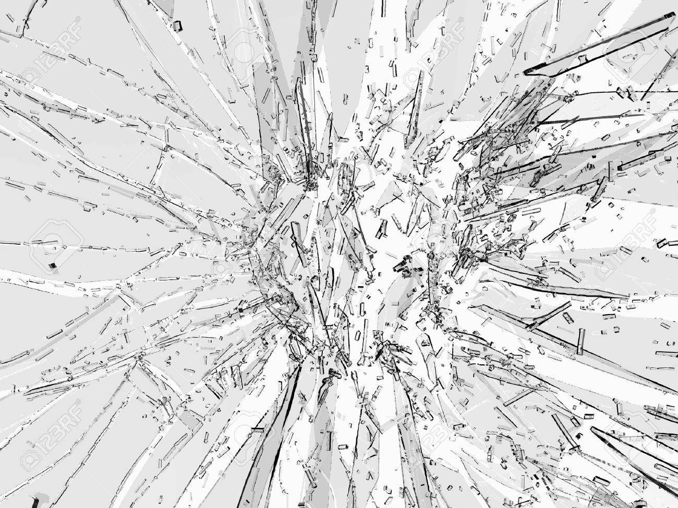

Slide 11
BC Plan + WFH Shattered
IT Not Scalable

Slide 12
BC Plan + WFH Shattered
IT Not Scalable
All Emps Needed New Equipment

Slide 13
BC Plan + WFH Shattered
IT Not Scalable
All Emps Needed New Equipment
All Emps Needed New Software

Slide 14
BC Plan + WFH Shattered
IT Not Scalable
All Emps Needed New Equipment
All Emps Needed New Software
Wi-Fi + Electrical Issues at Home

Slide 15
BC Plan + WFH Shattered
IT Not Scalable
All Emps Needed New Equipment
All Emps Needed New Software
Wi-Fi + Electrical Issues at Home
Org Needed Security Upgrade

Slide 16
BC Plan + WFH Shattered
IT Not Scalable
All Emps Needed New Equipment
All Emps Needed New Software
Wi-Fi + Electrical Issues at Home
Org Needed Security Upgrade
Mgmt Needed New Skills

Slide 17
BC Plan + WFH Shattered
IT Not Scalable
All Emps Needed New Equipment
All Emps Needed New Software
Wi-Fi + Electrical Issues at Home
Org Needed Security Upgrade
Mgmt Needed New Skills
Command, Control, Comms Seriously Challenged

Slide 18
BC Plan + WFH Shattered
IT Not Scalable
All Emps Needed New Equipment
All Emps Needed New Software
Wi-Fi + Electrical Issues at Home
Org Needed Security Upgrade
Mgmt Needed New Skills
Command, Control, Comms Seriously Challenged

Slide 19
BC Plan + WFH Shattered
Simple
?
IT Not Scalable
All Emps Needed New Equipment
All Emps Needed New Software
Wi-Fi + Electrical Issues at Home
Org Needed Security Upgrade
Mgmt Needed New Skills
Command, Control, Comms Seriously Challenged

Slide 21
WFH Not Simple Complicated

Slide 22
For Every Complex Problem…

Slide 23
For Every Complex Problem, There’s a Simple Solution

Slide 24
For Every Complex Problem, There’s a Simple Solution That’s Always Wrong

Slide 25
Return to Work: The Most Important Issue You’ve Completely Overlooked

Slide 26
Return to Work: The Most Important Issue You’ve Completely Overlooked
Simple
?

Slide 27
Reopening Guidelines
Recreate Pandemic Plan.
Train + Exercise
Masks, Distancing, Vectoring, Flex Time, etc.
ID Sick, Exposure, Testing, Vaxing
Reconfigure Workplace
Follow Existing OSHA Standards

Slide 28
Reopening Guidelines
Emps
Fully
Expect These
Recreate Pandemic Plan.
Train + Exercise
Masks, Distancing, Vectoring,
Flex Time, etc.
ID Sick, Exposure, Testing, Vaxing
Reconfigure Workplace
Follow Existing OSHA Standards

Slide 29
Return to Work: The Most Important Issue You’ve Completely Overlooked

Slide 30
Return to Work: The Most Important Issue You’ve Completely Overlooked
Trust

Slide 31
Trust
Trust

Slide 32
Trust
in You as the Boss

Slide 33
84% of Bosses Feel They’re Doing a “Great Job” During Covid-19
15Five Survey

Slide 34
Only Half of US Employees Deem Office Spaces Safe
Edelman Trust Barometer Special Report:
Workplace Trust and the Coronavirus

Slide 35
86% of workers say they don’t trust their CEOs and Sr. Mgrs. to safely lead them back to work
Edelman Trust Barometer Special Report:
Workplace Trust and the Coronavirus

Slide 36
29% of workers would look for a new job rather than return to a site that has not implemented necessary safety measures
Edelman Trust Barometer Special Report:
Workplace Trust and the Coronavirus

Slide 37
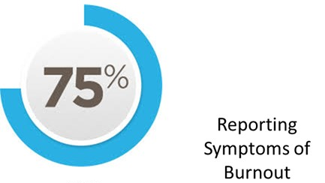

Slide 38
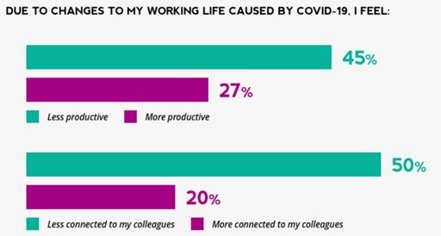

Slide 39
84% of Bosses Feel They’re Doing a “Great Job” During Covid-19
15Five Survey

Slide 40
86% of workers say they don’t trust their CEOs and Sr. Mgrs. to safely lead them back to work
Edelman Trust Barometer Special Report:
Workplace Trust and the Coronavirus

Slide 42
Bo Mitchell
911 Consulting
President
Police Commissioner (Ret.)

Slide 44
Bo Mitchell
911 Consulting
President
Police Commissioner (Ret.)
Certified Emergency Manager
CEM, CPP, CHS-V, CBCP, CSI-ML, HSEEP, CNTA, IAC, MOAB, CHSP, CHEP, CSHM, CESCO, CHCM, CFC, CSSM, CSC, CAS, TFCT3, CERT, CHSEMR, CMC

Slide 45
911 Consulting Clients
GE HQ
Subway HQ
Hyatt Corp HQ
Rolls Royce HQ
Swiss Army HQ
Cablevision
ExxonMobil
Goodrich
Pratt & Whitney
MasterCard HQ

Slide 46
911 Consulting Clients
26 K-12
20 Camps
5 Colleges + Universities

Slide 47
911 Consulting Clients
Worst Prepared
US
26 K-12
20 Camps
5 Colleges + Universities

Slide 48
56
High Rises Nationwide

Slide 49
56 High Rises
San Fran
Detroit
Chicago
Atlanta
Crystal City
KCMO
Boston
D.C.
Seattle
Stamford
Phila
NYC
N.O.
Houston

Slide 50
Speaker
OSHA
SHRM
RIMS
IFMA
ASSP
NFPA
FEMA

Slide 51
Speaker: BC
ACP Natl
ACP Webinars
ACP NYC
ACP Boston
ACP PA
ACP CT
EGLACP

Slide 52
Speaker: BC
CPAC
CPE
Cont Insights
DRI
EEI
EUCI
NEDRIX
SNUG

Slide 53
Expert Consultant
Landmark Legal Cases
Expected Settlements:
$1 Billion Each
“Failure to Plan”
“Failure to Train”

Slide 54
How Long Will COVID19 Last?

Slide 55
We Have a Precident

Slide 56
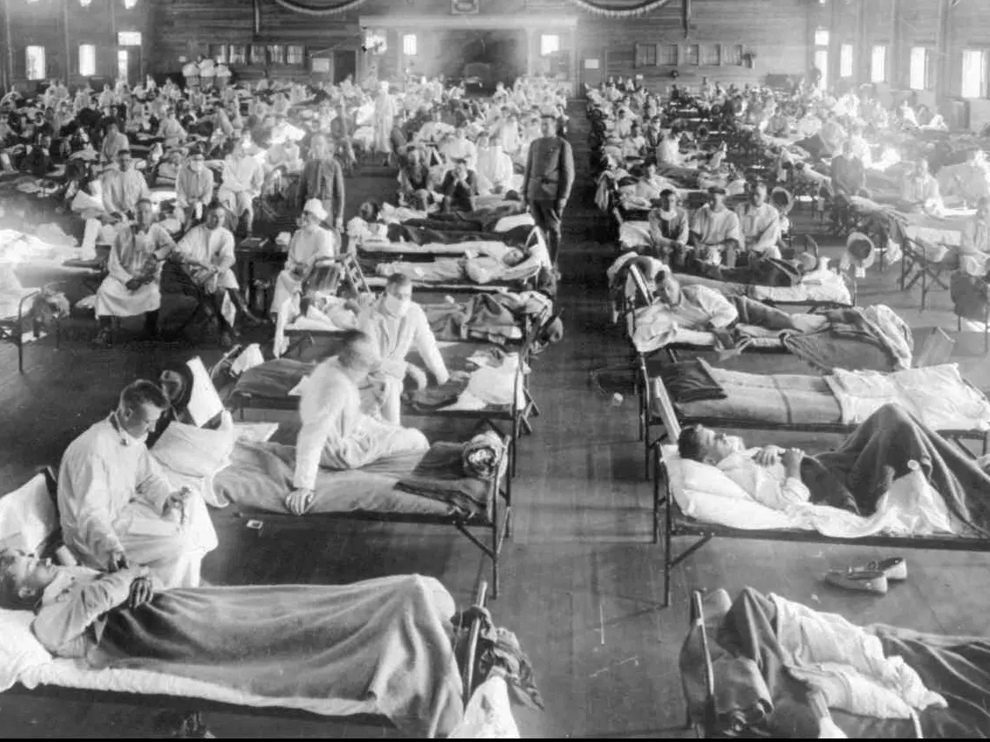
1918-1920 Pandemic

Slide 57
Dead Americans
650,000
1918-1920 Pandemic

Slide 58
Equals
2 Million
Today
1918-1920 Pandemic

Slide 59
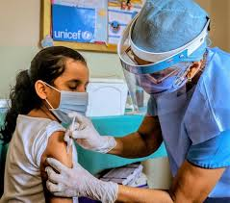
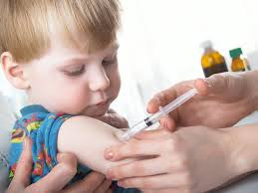

Slide 60
330,000 Americans
330,000
Americans

Slide 61
330,000 Americans
330,000
Americans
X2

Slide 62
330,000 Americans
330,000
Americans
X3

Slide 63
330,000 Americans
330,000
Americans
X4

Slide 64
Spring
2022

Slide 65
For Every Complex Problem, There’s a Simple Solution That’s Always Wrong

Slide 66
Return to Work: The Most Important Issue You’ve Completely Overlooked

Slide 67
Trust

Slide 68
Trust
in You as the Boss

Slide 69
86% of workers say they don’t trust their CEOs and senior managers to safely lead them back to work
Edelman Trust Barometer Special Report:
Workplace Trust and the Coronavirus

Slide 70
Why
Don’t Emps Trust You

Slide 71
Reopening Guidelines
Recreate Pandemic Plan.
Train + Exercise
Masks, Distancing, Vectoring,
Flex Time, etc.
ID Sick, Exposure, Testing, Vaxing
Reconfigure Workplace
Follow Existing OSHA Standards

Slide 72
Reopening Guidelines
Emps
Fully
Expect These
Recreate Pandemic Plan.
Train + Exercise
Masks, Distancing, Vectoring,
Flex Time, etc.
ID Sick, Exposure, Testing, Vaxing
Reconfigure Workplace
Follow Existing OSHA Standards

Slide 73
Why
Don’t Emps Trust You

Slide 74
Trust You???
Commute
Policing Your Procedures
Food Chain
Requiring Masks, Vax, etc.
Workplace Violence
Civil Unrest
Weapons at Work
All Hazards

Slide 75
Trust You???
Commute

Slide 76
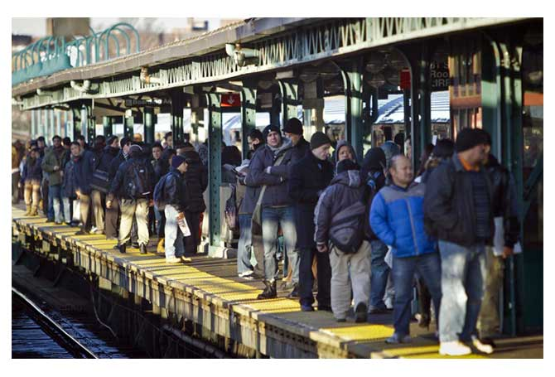

Slide 77
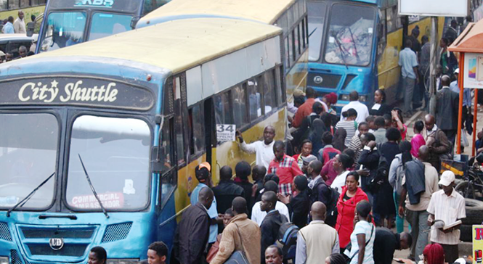

Slide 78
Car Pooling

Slide 79
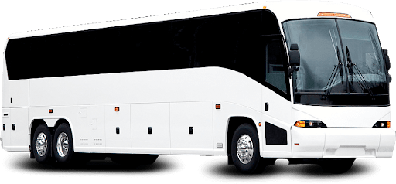
Your Co.

Slide 80
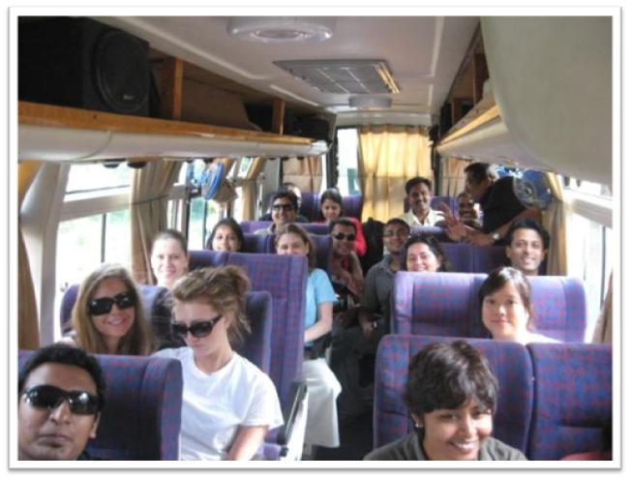

Slide 81
Trust You???
Commute
Policing Your Procedures

Slide 82
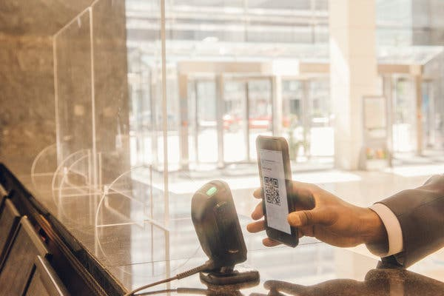
Bldg Reception? Your Reception?

Slide 83
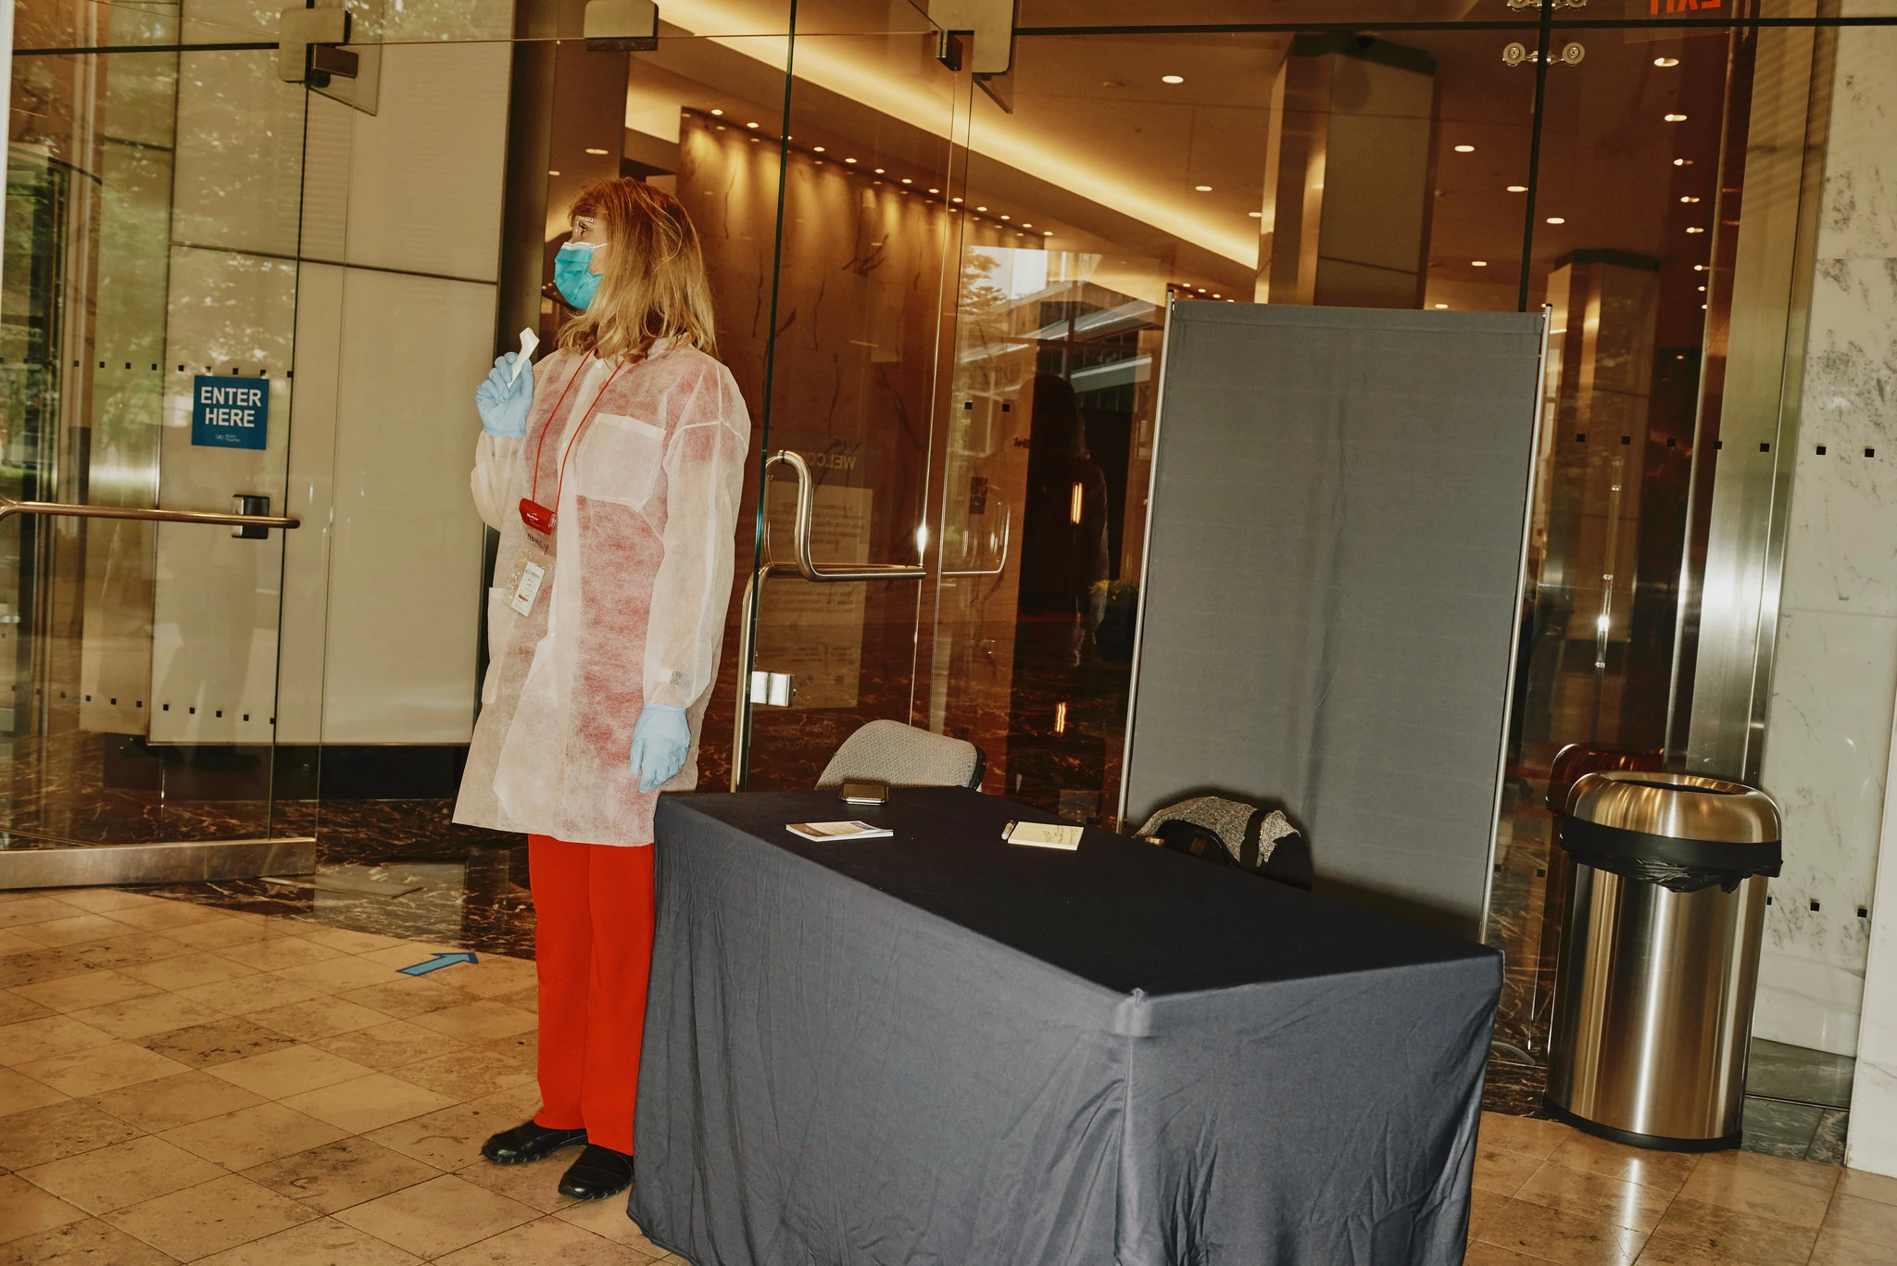

Slide 84
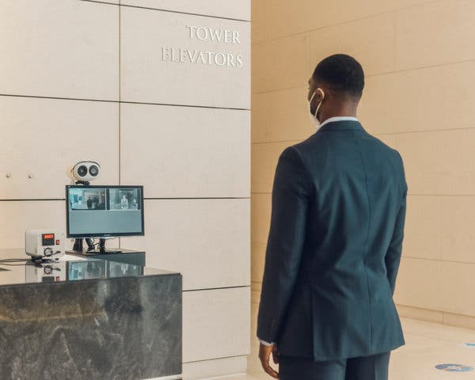
Temperature Testing Widespread

Slide 85
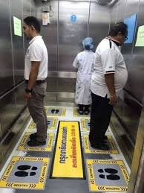

Slide 86
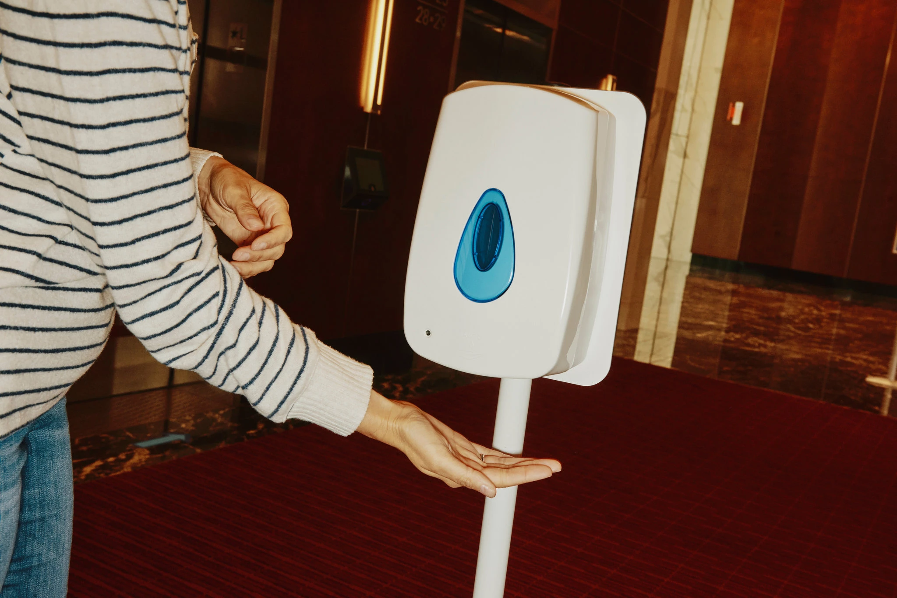

Slide 87
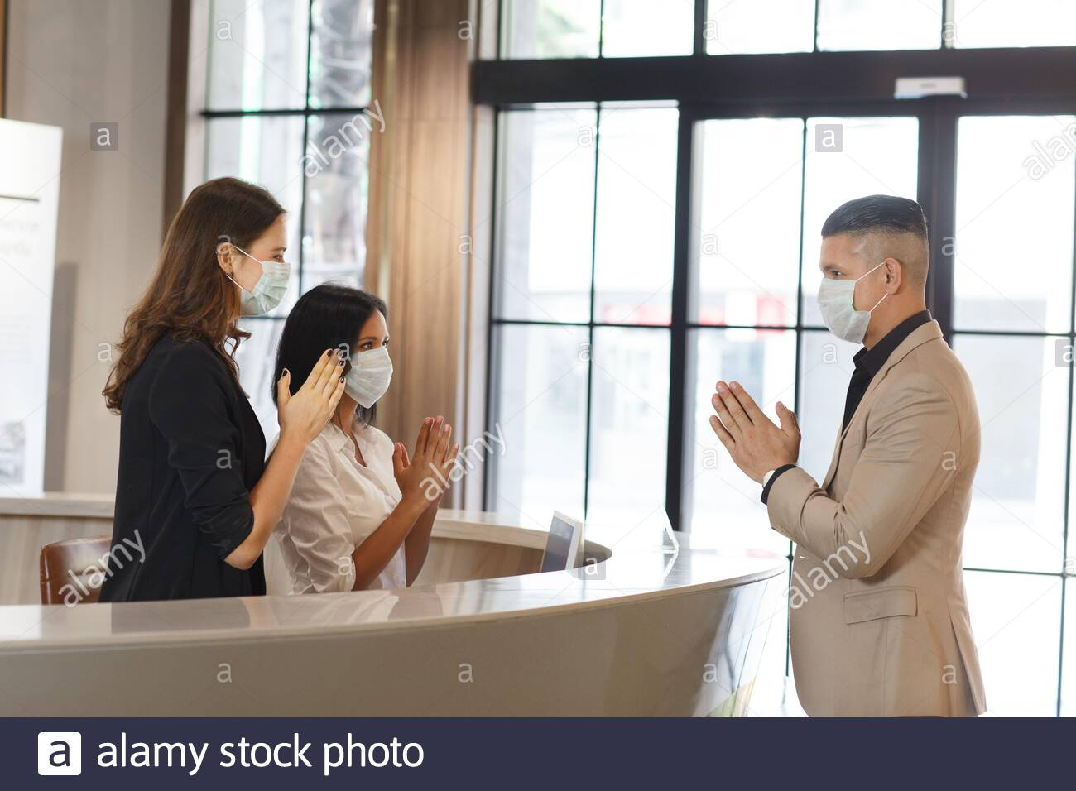
Visitors?

Slide 90
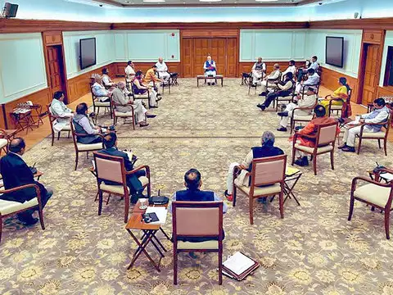

Slide 93
Trust You???
Commute
Policing Your Procedures
Food Supply Chain

Slide 94
Ya Gotta Eat

Slide 95
Ya Gotta Eat
Keep Emps In?
Out/Back OK?
Meals fr Home
How to Store/ Refrigerate
Serving
Catering
Delivery
Clean Up/Disposal

Slide 96
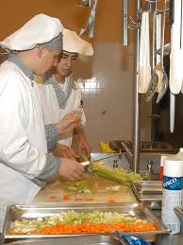

Slide 99
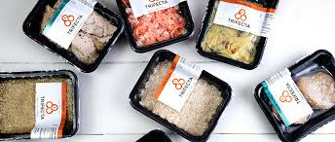

Slide 100
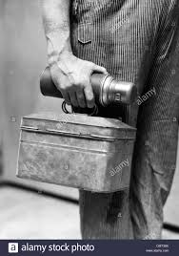

Slide 101
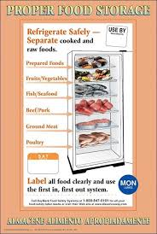
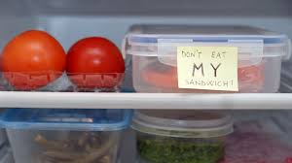

Slide 103
Trust You???
Commute
Policing Your Procedures
Food Supply Chain
Req. Masks, Vax, etc.

Slide 105
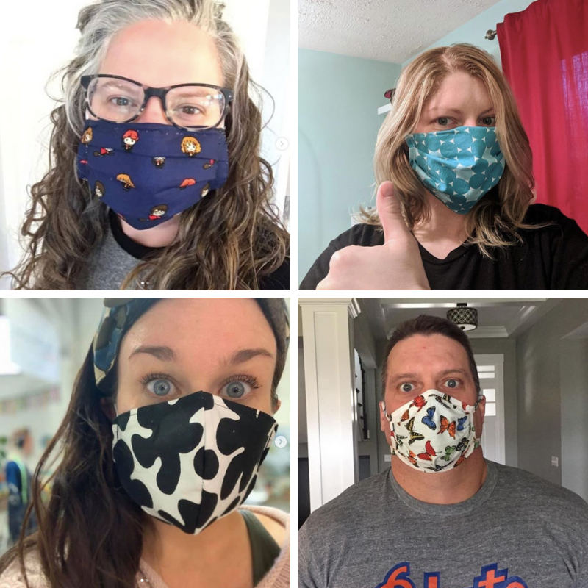
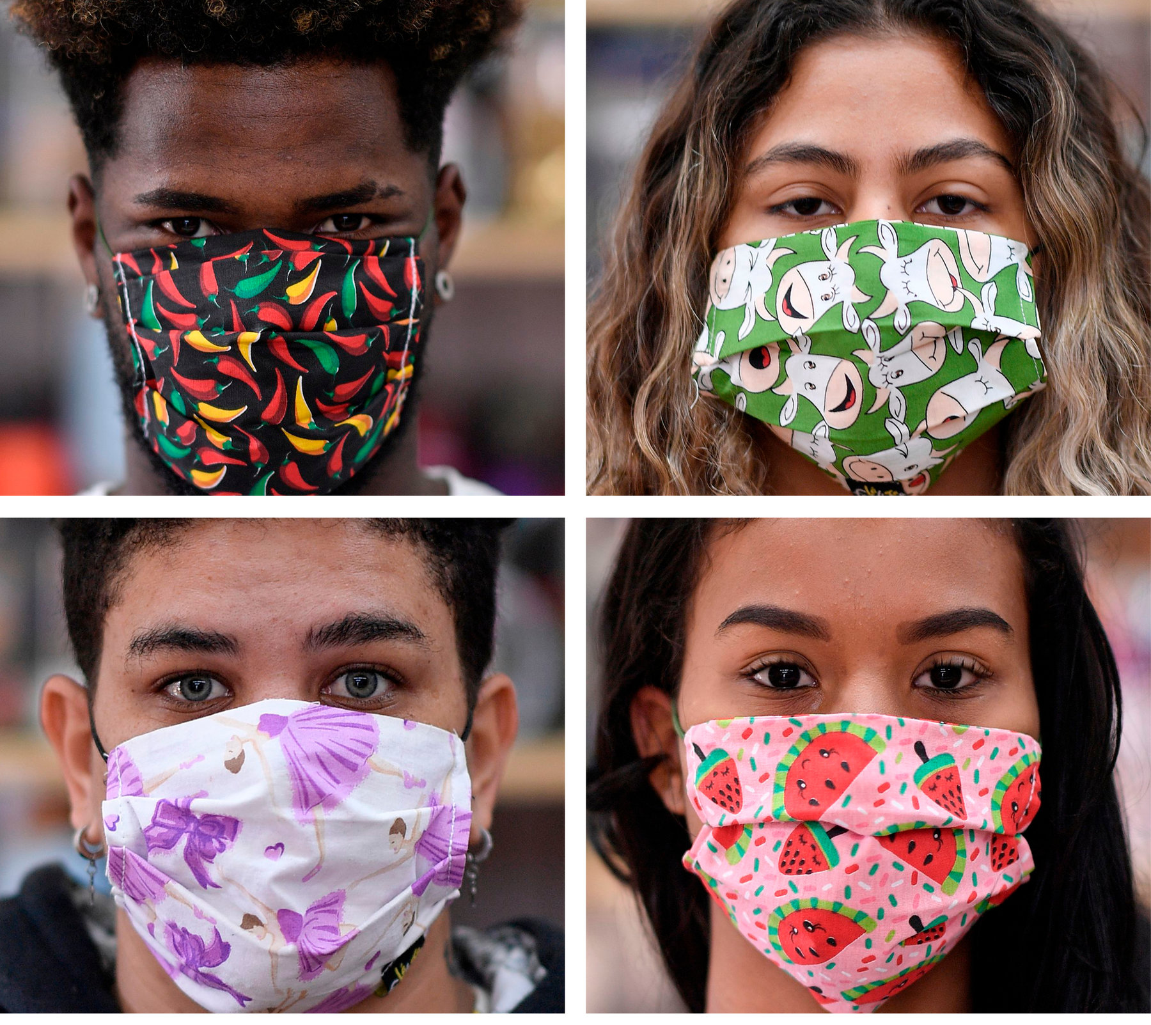

Slide 106
OK!

Slide 107
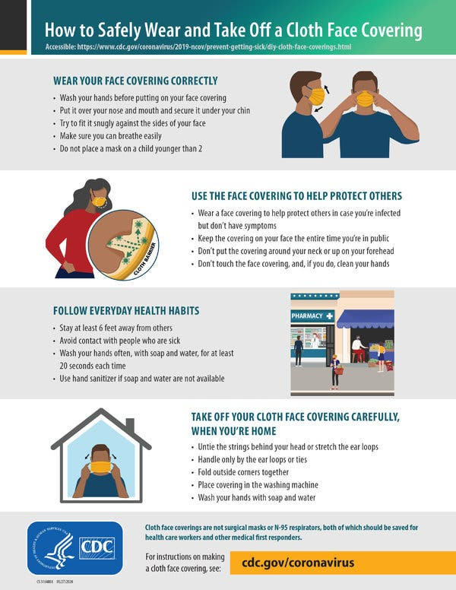
Is It Employer’s Requirement for Employees
Issue No Cost?

Slide 108
Is It Employer’s Requirement to Train Employees on
How to Fit?

Slide 109
Is It Employer’s Requirement to Train Employees on How to Fit?
How to Use?

Slide 110
Is It Employer’s Requirement to Train Employees on How to Fit? How to Use?
How to Clean + Maintain?

Slide 111
Is It Employer’s Requirement to Train Employees on How to Fit? How to Use? How to Clean + Maintain?
How to Dispose?

Slide 112
Is It Employer’s Requirement to Train Employees on How to Fit? How to Use? How to Clean + Maintain? How to Dispose?
How to Replace?

Slide 113
Replace at No Cost?
Is It Employer’s Requirement to Train Employees on How to Fit? How to Use? How to Clean + Maintain? How to Dispose? How to Replace?

Slide 114
Is It Employer’s Requirement to Train Employees on How to Fit? How to Use? How to Clean + Maintain? How to Dispose? How to Replace?
Yes!

Slide 115
29 CFR 1910.132
Yes!

Slide 116
All of 2022?

Slide 118
Vax
Can You Require?
Is that a Good Idea?
State? Local? You?
When? How?

Slide 119
Trust You???
Commute
Policing Your Procedures
Food Chain
Requiring Masks, Vax, etc.
Workplace Violence

Slide 120
Threats
2 million
Workplace Violence
Annually
DOJ

Slide 121
Facts: WPV
2 people murdered/day!
Every hour:
26 rapes
44 robberies
207 aggravated assaults
938 simple assaults
3,125 threats

Slide 122
18x
More Likely to Have
Violence than a Fire
at Work
DOJ & NFPA

Slide 123
Intimate Partner Violence

Slide 124
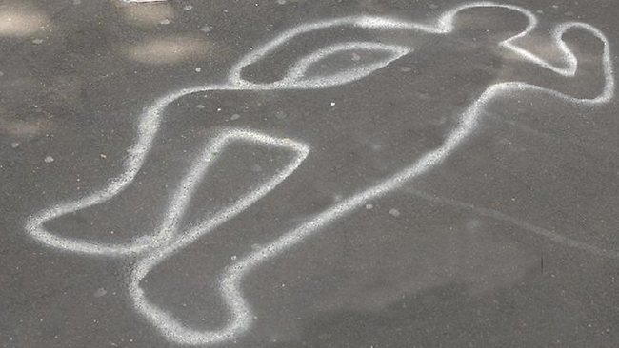
Intimate Partner
Violence Kills
1,300 Every Year

Slide 125
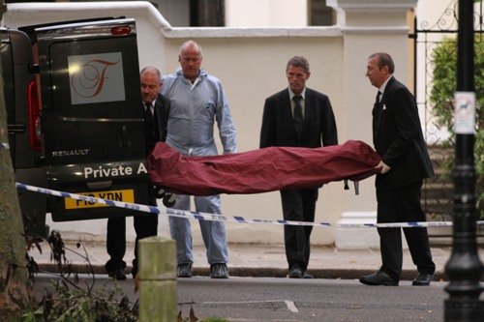
2 Workplace Homicides Every Day

Slide 126
All of 2022?

Slide 127
Workplace Bullying

Slide 128
Every A.S. Has Been Bullied: ✓School ✓Work ✓Neighborhood

Slide 129
30%
Murder Rate: Top 34 U.S.
Cities
CY 2020 v. CY 2019

Slide 130
30%
During
COVID 19
Murder Rate: Top 34 U.S.
Cities

Slide 131
100%
Mass Shootings
(4+ Injured or Killed)
In CY 2020 v. Ave of 5 Previous Years

Slide 132
100%
During
COVID 19
Mass Shootings
(4+ Injured or Killed)
In CY 2020 v. Ave of 5 Previous Years

Slide 133
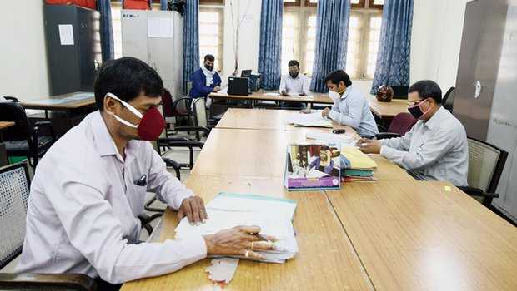
Stress
Work
Family/School
Commuting
2nd Wave
Another Quarantine
Family Income

Slide 134
Yellow Flags Employees Who May Become Violent
Fascination w weapons/incidents of violence
General narcissistic attitude
Disruptive outbursts or temper flare-ups disproportional to source of agitation
Consistent attempts to argue against co-workers
Tendency to interpret daily events in a morbid or pernicious way
Consistent display of "victim-syndrome"
Controlling or demanding personality
General tendency to make
co-workers uncomfortable
Proponent of general and "inter-office" conspiracy theories
Multiple gun ownership
Consistent complaints, negative comments, or consistently filing grievances
Persistent, inappropriate anger
Affiliation with fringe, anti-government, or racist organizations
Indications of drug or alcohol abuse

Slide 135
Yellow Flags Employees Who May Become Violent
Train
Your
Employees
Fascination w weapons/incidents of violence
General narcissistic attitude
Disruptive outbursts or temper flare-ups disproportional to source of agitation
Consistent attempts to argue against co-workers
Tendency to interpret daily events in a morbid or pernicious way
Consistent display of "victim-syndrome"
Controlling or demanding personality
General tendency to make
co-workers uncomfortable
Proponent of general and "inter-office" conspiracy theories
Multiple gun ownership
Consistent complaints, negative comments, or consistently filing grievances
Persistent, inappropriate anger
Affiliation with fringe, anti-government, or racist organizations
Indications of drug or alcohol abuse

Slide 136
Red Flags Employees Who May Become Violent
Suffers what the individual considers a profound, public humiliation
Passed over for promotion
Individual makes critical mistake that negatively affects the company
Individual is publicly reprimanded
Individual is teased or otherwise harassed
Individual is fired,
laid-off, "downsized"
Personal life trauma resulting in a feeling of helplessness
Divorce, separation
Death of spouse, family member
Dramatic increase in anxiety, anger, depression (swift, observable mood swing)

Slide 137
Red Flags Employees Who May Become Violent
Train
Your
Employees
Suffers what the individual considers a profound, public humiliation
Passed over for promotion
Individual makes critical mistake that negatively affects the company
Individual is publicly reprimanded
Individual is teased or otherwise harassed
Individual is fired,
laid-off, "downsized"
Personal life trauma resulting in a feeling of helplessness
Divorce, separation
Death of spouse, family member
Dramatic increase in anxiety, anger, depression (swift, observable mood swing)

Slide 138
All of 2022?

Slide 139
Trust You???
Commute
Policing Your Procedures
Food Chain
Requiring Masks, Vax, etc.
Workplace Violence
Civil Unrest

Slide 140
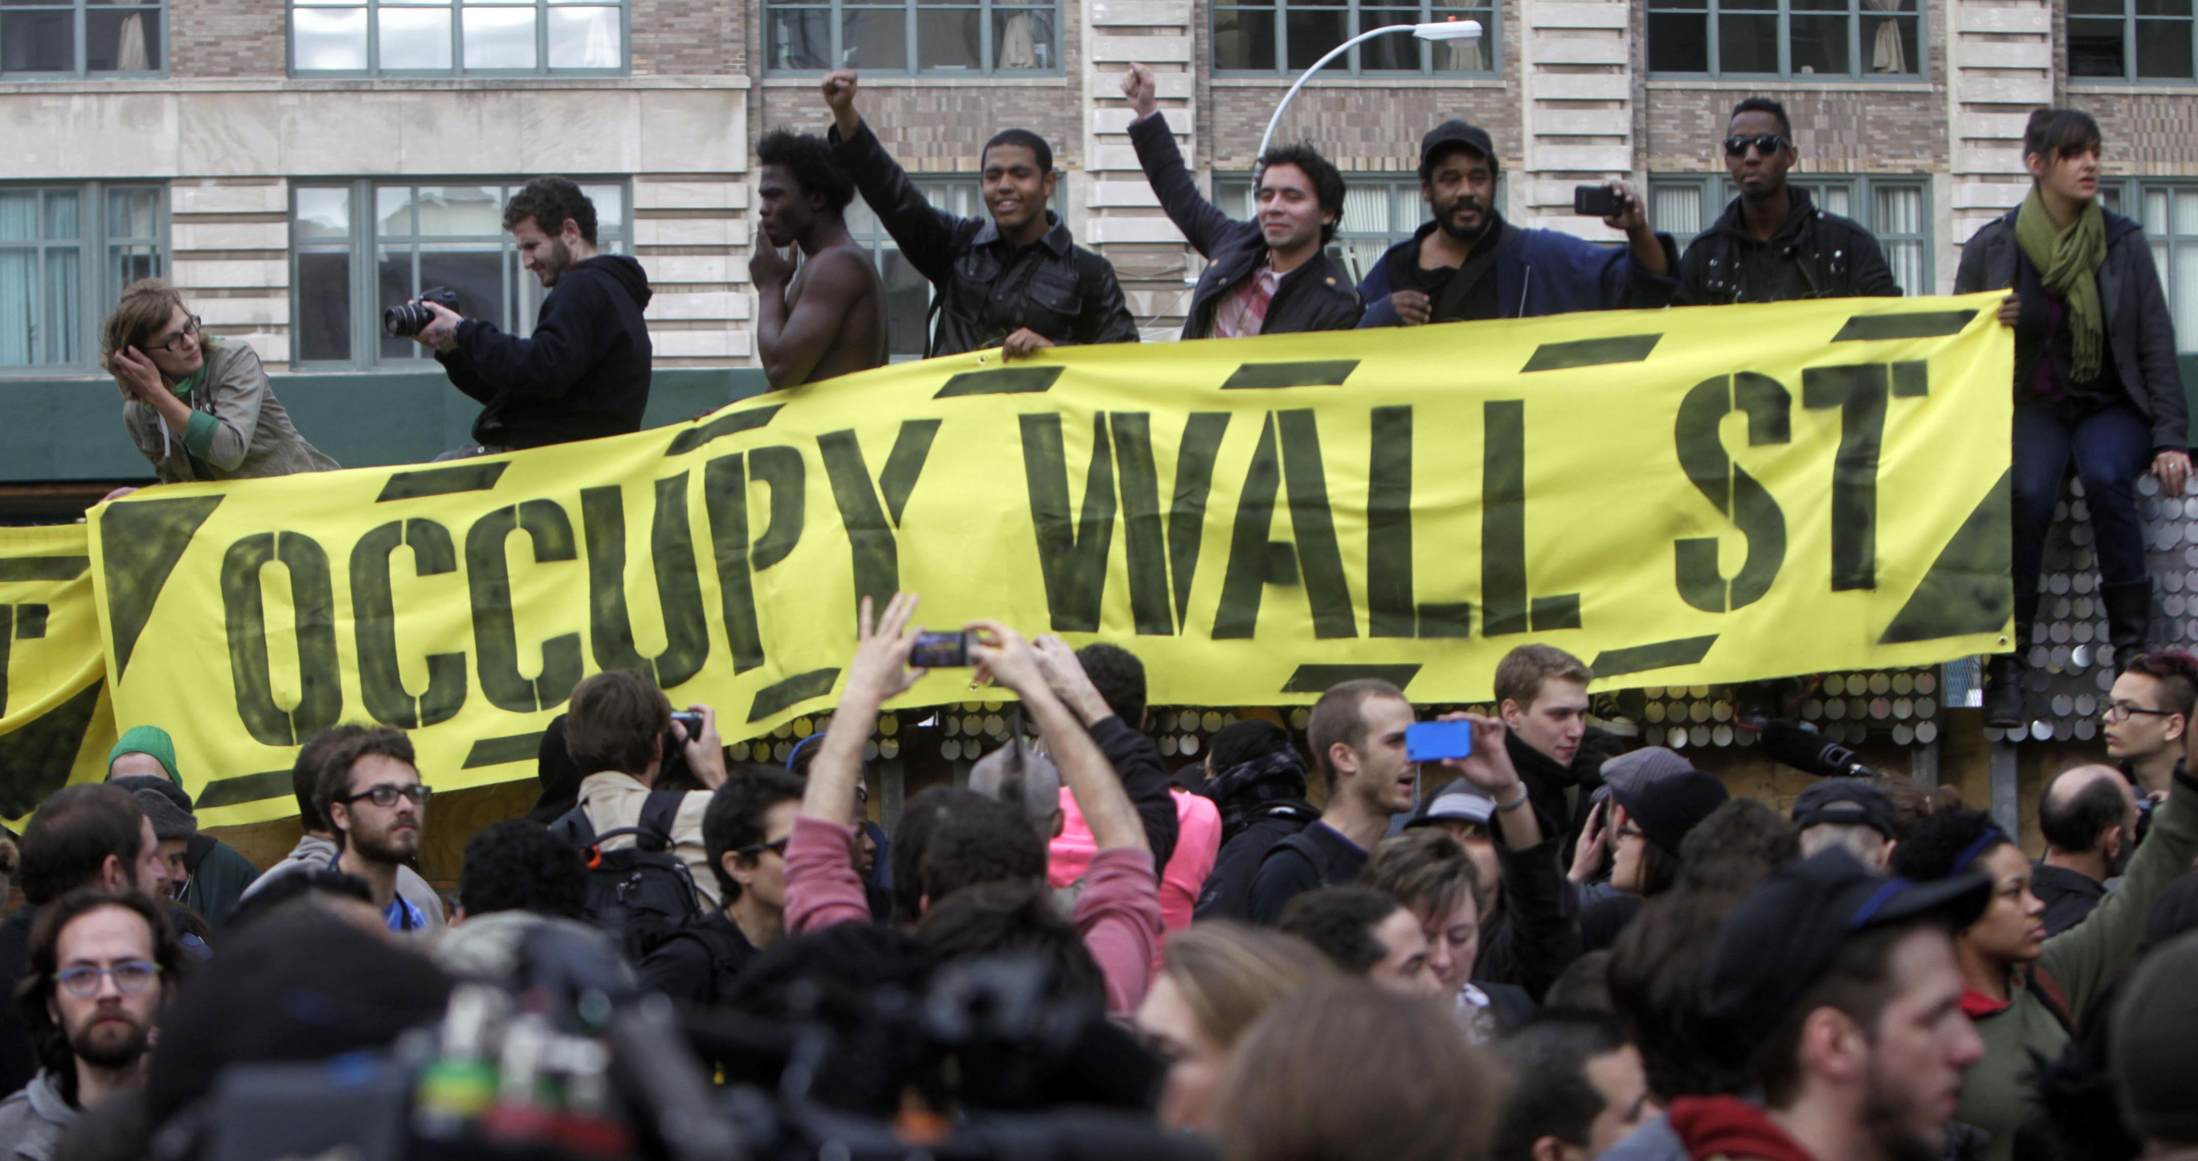
17Sep11-24Mar12

Slide 141
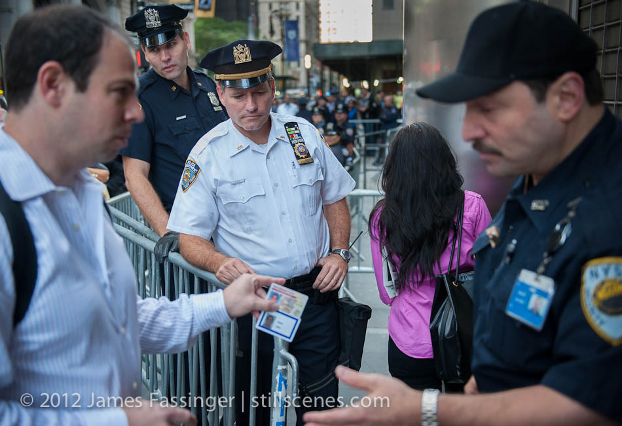

Slide 142
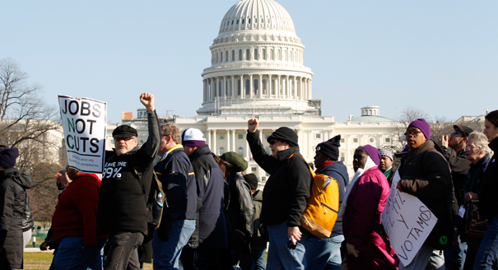

Slide 143
Trust You???
Commute
Policing Your Procedures
Food Chain
Requiring Masks, Vax, etc.
Workplace Violence
Civil Unrest
Weapons at Work

Slide 144
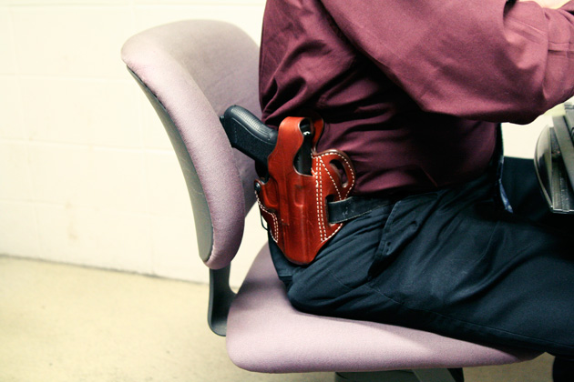
Guns at Work?

Slide 145
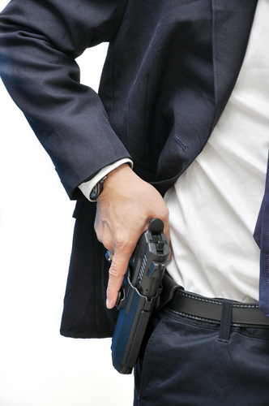

Slide 146
200%
Guns Seized at Airports
CY 2020 v.
CY 2019

Slide 147
200%
During
COVID 19
Guns Seized at Airports
CY 2020 v.
CY 2019

Slide 148
Guns Seized at Airports
83%
Loaded

Slide 150
Police
Probably
Won’t
Come

Slide 151
Police
Probably
Won’t
Come

Slide 152
“We’re in the Law Enforcement Biz”

Slide 153
“Not the Co. Policy Enforcement Biz”

Slide 154
“What’s Your Policy? Procedures?”

Slide 155
Trust You???
Commute
Policing Your Procedures
Food Chain
Requiring Masks, Vax, etc.
Workplace Violence
Civil Unrest
Weapons at Work
All Hazards

Slide 158
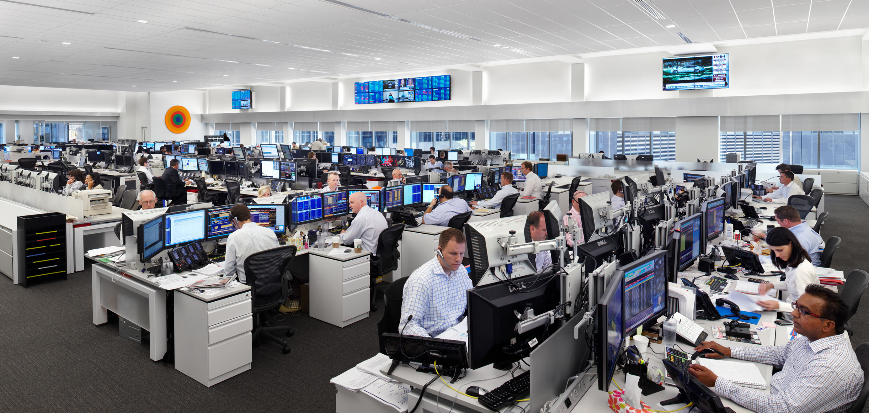

Slide 160
Recon-figure Your Space?

Slide 161
Recon-figure Your Space?

Slide 162
Recon-figure Your Space?
Trigger
For
Training

Slide 163
Recon-figure Your Space?
Training
Required
By Law

Slide 164
Your

Slide 165
?

Slide 166
KENOSHA? OSHKOSH?
Wisconsin

Slide 167
Required
by Federal Law

Slide 168
OSHA
29 CFR
1910.34

Slide 169
Mandatory
29 CFR 1910.38/.39
Emergency Action Plan
Fire Prevention Plan

Slide 171
1600

Slide 172
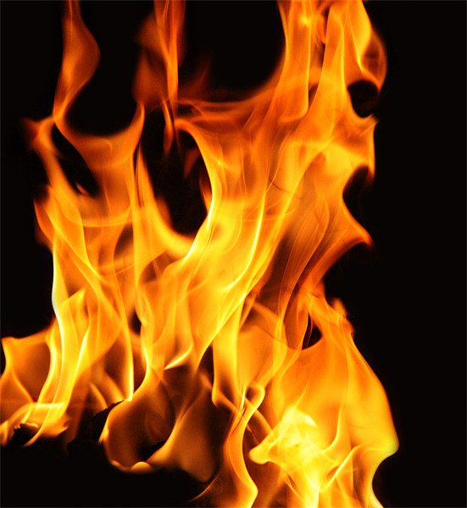

Slide 173
All-Hazards Plan: Shall
Emergency Team
Chain of Command
Visitors
Contractors
Civil Disturbance
Special Needs
Headcounts
Evacuation
In-Building Relo
AAs
Fire
Bomb Threat
Medical Em
Security
Active Shooter
Hostage
Lockout
Suicide
Bullying
Perimeter Access
Security Aft Hours
Chemical Spill: In
Chemical Spill: Out
Shelter in Place
Suspicious Pkg
Suspicious Person
Explosion
Structural Failure
Severe Weather
Elevator Em
Power Outage
Water/Phone Out
Lockdown
Air Quality
Em Shutdown
Earthquake
Flooding
Pipe Burst
CBRNE
Terrorism
Use of FEs
Training
Drills
Exercises
Search-Seizure
Weapons
Evac Maps
Em Contacts
Pandemic: COVID 19
1600

Slide 174
Duty of Care

Slide 175
Affirmative Duty of Care

Slide 176
“Everything Is Always My Fault”

Slide 177
Duty of Care
Employee
No Duty

Slide 178
Duty of Care

Slide 179
General Duty Clause
“each employer shall
furnish …a place of employment …free from recognized hazards that are causing or are likely to cause death or serious physical harm to employees.”

Slide 180
Threats
4.1 MM
Workplace Injuries
Annually
DOJ

Slide 181
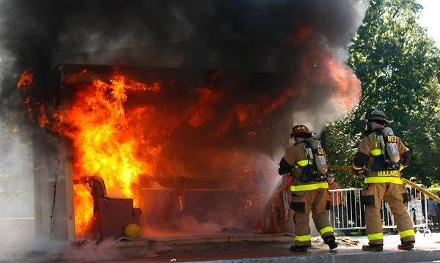
111,500 Structural Fires at Work:

Slide 182
Threats
349,500
HazMat
Spills
NFPA

Slide 183
Threats
HazMat Spills
800,000 Shpmnts Daily
60,000 Spills Yearly
Train-on-Vehicle Collision:
Every 90 minutes
DOT & EPA
U.S. DOT

Slide 184
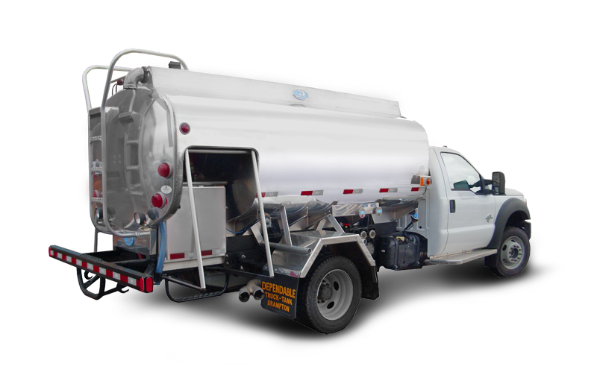
Chlorine

Slide 185
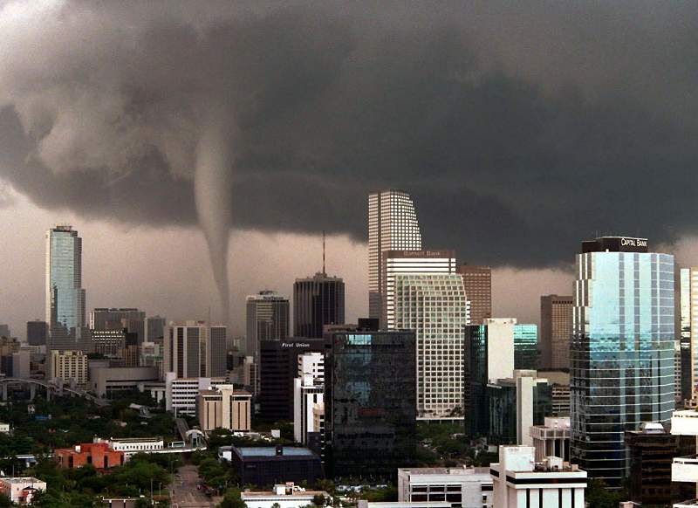

Slide 186
Workplace Bullying

Slide 187
Stalking @ Workplace

Slide 192
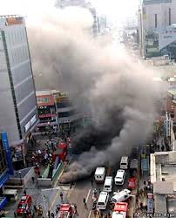

Slide 194
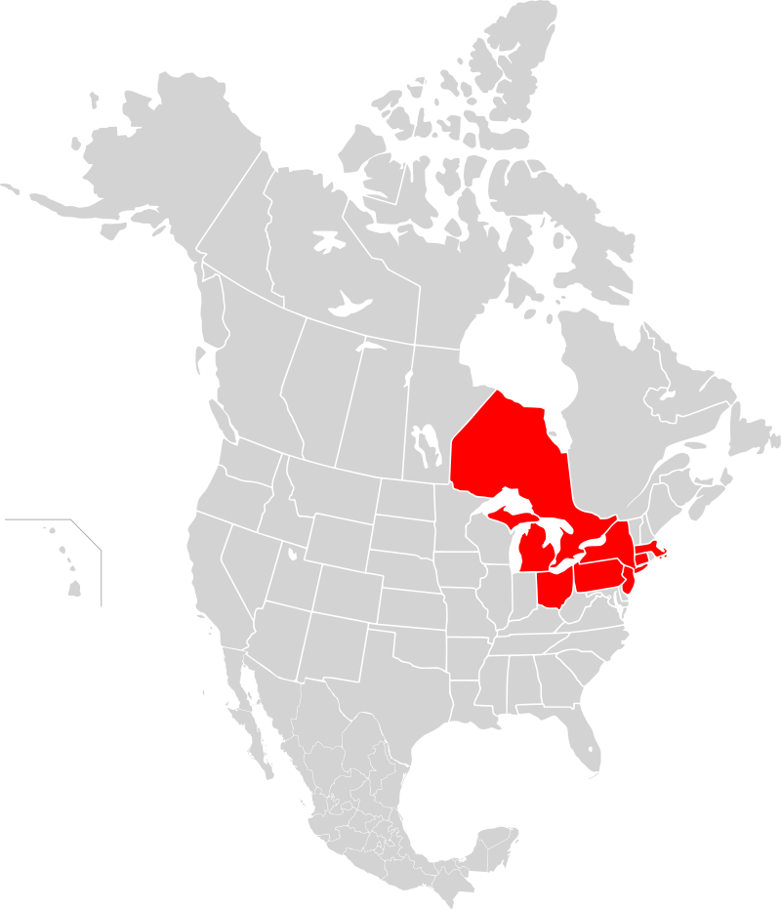
14 Aug 2003

Slide 195
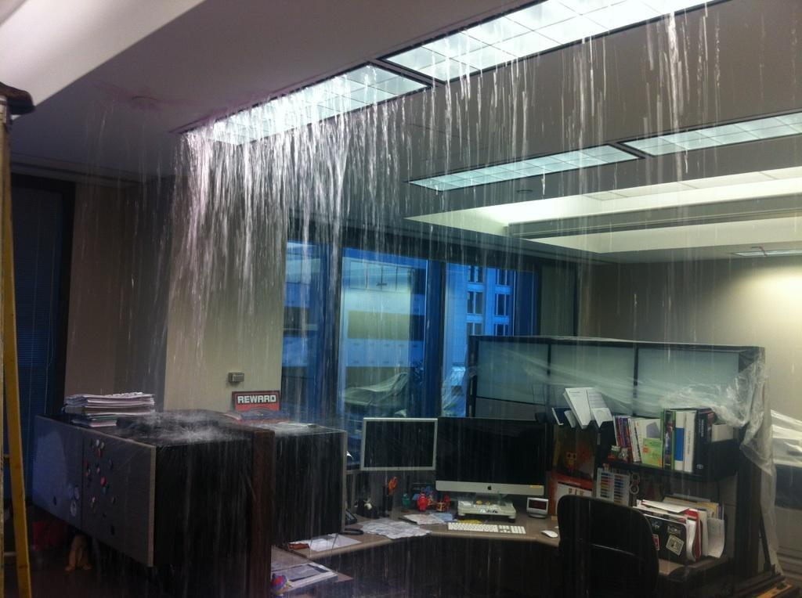

Slide 196
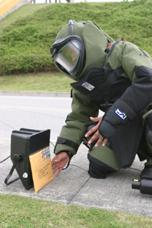

Slide 197
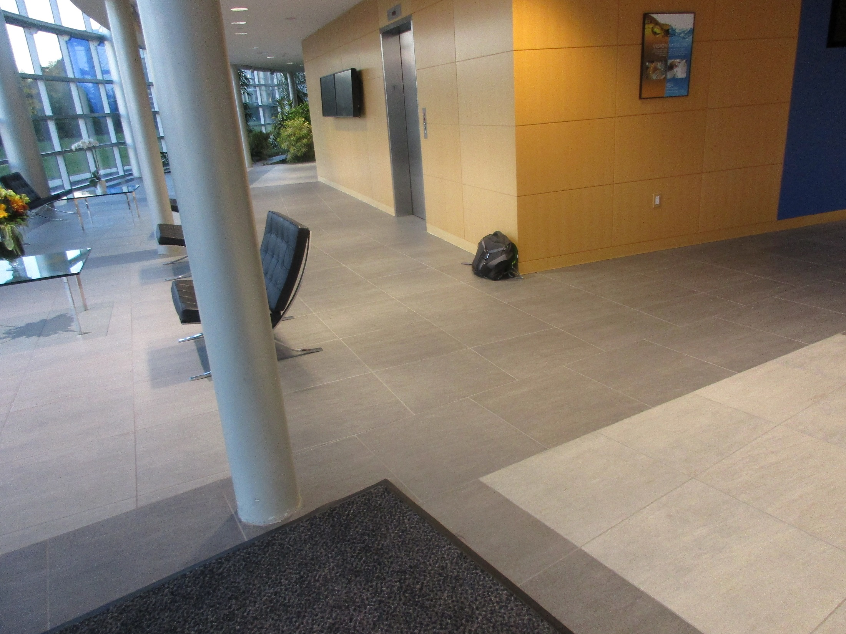

Slide 198
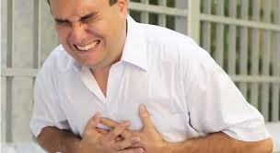
10,000: Work

Slide 199
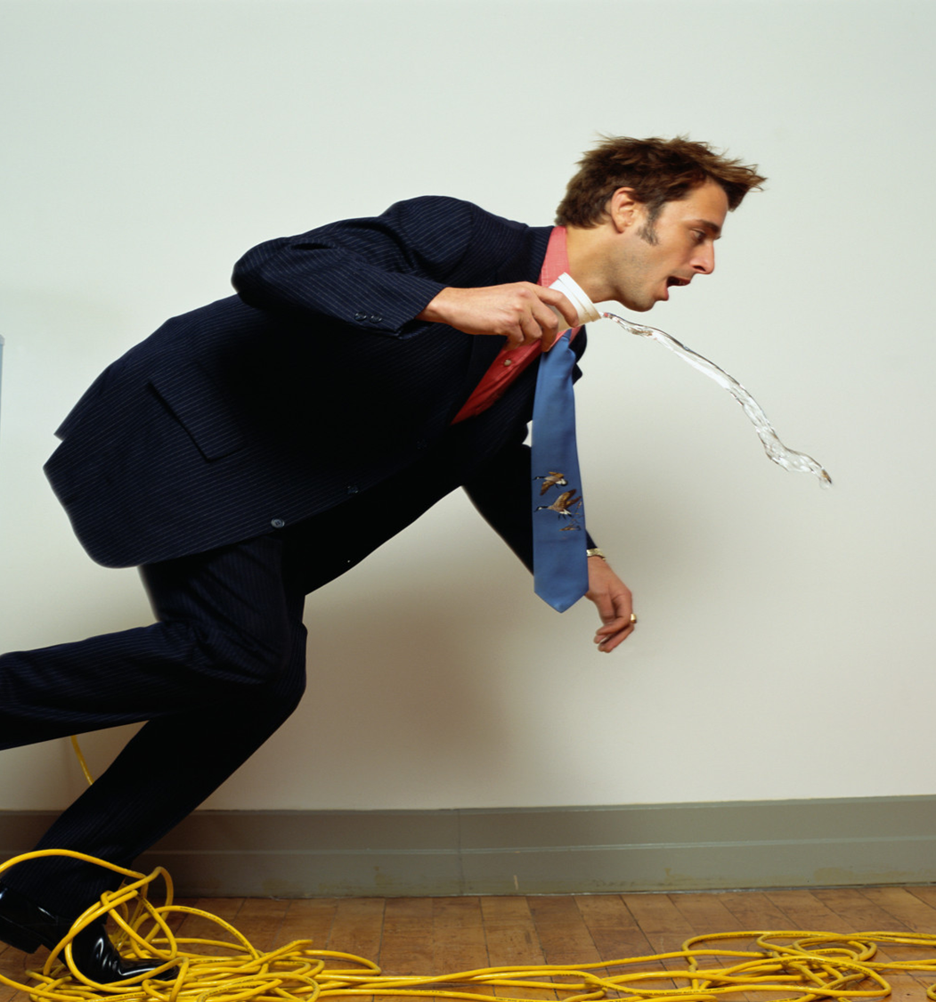
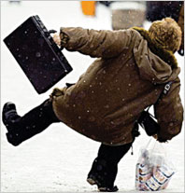

Slide 200
Threats
5,100
Workplace
Deaths
OSHA

Slide 201
Threats
1 Million
Calls to
911 Every Day

Slide 202
?

Slide 204
Nov ‘20

Slide 205
Mandatory
29 CFR 1910.38/.39
Emergency Action Plan
Fire Prevention Plan

Slide 207
1600

Slide 208
General Duty Clause
“each employer shall
furnish …a place of employment …free from recognized hazards that are causing or are likely to cause death or serious physical harm to employees.”

Slide 209
Your Plan???
Fire
Evacuation
Headcounts
Bomb
Chem Spill
Drills
Weather
Sus Pkg
Sus Pers
Pwr Out

Slide 210
All-Hazards Plan: Shall
Emergency Team
Chain of Command
Visitors
Contractors
Civil Disturbance
Special Needs
Headcounts
Evacuation
In-Building Relo
AAs
Fire
Bomb Threat
Medical Em
Security
Active Shooter
Hostage
Lockout
Suicide
Bullying
Perimeter Access
Security Aft Hours
Chemical Spill: In
Chemical Spill: Out
Shelter in Place
Suspicious Pkg
Suspicious Person
Explosion
Structural Failure
Severe Weather
Elevator Em
Power Outage
Water/Phone Out
Lockdown
Air Quality
Em Shutdown
Earthquake
Flooding
Pipe Burst
CBRNE
Terrorism
Use of FEs
Training
Drills
Exercises
Search-Seizure
Weapons
Evac Maps
Em Contacts
1600

Slide 211
?

Slide 212
1,000+
Emergency Plans Reviewed

Slide 213
Compliant?

Slide 214
Compliant?
1

Slide 215
3 Things Guaranteed in Life

Slide 216
3 Things in Life Guaranteed
Death

Slide 217
3 Things in Life Guaranteed
Death
Taxes

Slide 218
3 Things in Life Guaranteed
Death
Taxes
You Do Not
Have: EAP Complies with
1600

Slide 219
Landlord?

Slide 220
4 Things Guaranteed in Life

Slide 221
4 Things in Life Guaranteed
Death

Slide 222
4 Things in Life Guaranteed
Death
Taxes

Slide 223
4 Things in Life Guaranteed
Death
Taxes
You Do Not
Have: EAP Complies with
1600

Slide 224
4 Things in Life Guaranteed
Death
Taxes
You Don’t Have: EAP
Your Landlord Does
NOT Have: EAP Complies with
1600

Slide 225
4 Things in Life Guaranteed
Death
Taxes
You Don’t Have: EAP
Your Landlord Does
NOT Have
for Himself…
1600

Slide 226
4 Things in Life Guaranteed
Death
Taxes
You Don’t Have: EAP
Your Landlord Does NOT
Have an
Himself…or for You.
1600

Slide 227
Parent Company: They Must Have This, Right?

Slide 228
5 Things Guaranteed in Life

Slide 229
5 Things in Life Guaranteed
Death
Taxes
You Don’t Have: EAP
Your Landlord Does NOT Have an
Himself or for You.
5. Your Parent Does
NOT Have: EAP Complies with
1600

Slide 230
?

Slide 231
?

Slide 232
?

Slide 233
?

Slide 234
All-Hazards Plan: Shall
Emergency Team
Chain of Command
Visitors
Contractors
Civil Disturbance
Special Needs
Headcounts
Evacuation
In-Building Relo
AAs
Fire
Bomb Threat
Medical Em
Security
Active Shooter
Hostage
Lockout
Suicide
Bullying
Perimeter Access
Security Aft Hours
Chemical Spill: In
Chemical Spill: Out
Shelter in Place
Suspicious Pkg
Suspicious Person
Explosion
Structural Failure
Severe Weather
Elevator Em
Power Outage
Water/Phone Out
Lockdown
Air Quality
Em Shutdown
Earthquake
Flooding
Pipe Burst
CBRNE
Terrorism
Use of FEs
Training
Drills
Exercises
Search-Seizure
Weapons
Evac Maps
Em Contacts
1600

Slide 238
All of 2022?

Slide 239
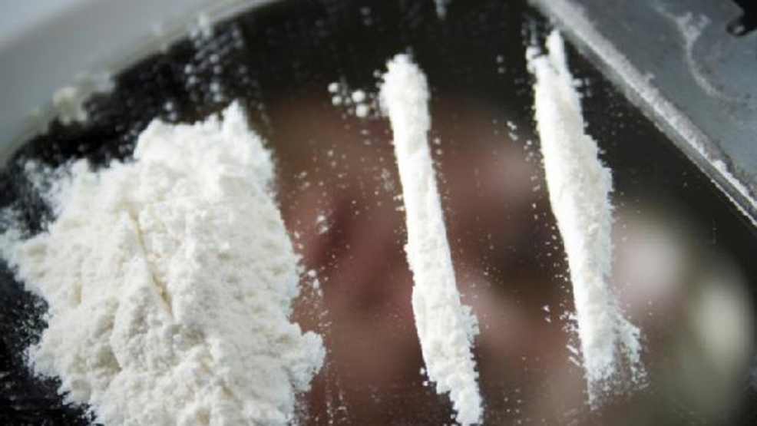

Slide 242
Drug Overdoses
45%
3/14/20-10/12/20 v. Yr. Ago

Slide 243
Drug Overdoses
During
COVID 19
45%
3/14/20-10/12/20 v. Yr. Ago

Slide 245
During
COVID 19

Slide 246
34%
.
U.S. DivorceFilings

Slide 247
DivorceFilings
During
COVID 19
U.S.
+30%
.
Divorce
Filings

Slide 251
COD: U.S. 2020
Auto Deaths: 38,680
Gun Deaths: 19,411

Slide 252
COD: U.S. 2020
Auto Deaths: 38,680
Gun Deaths: 19,411
Suicides:
47,511

Slide 253
Calls: Suicide Lifeline
Apr ‘19: 1,790

Slide 254
All of 2022?

Slide 255
Calls: Suicide Lifeline
Apr ‘19: 1,790 Apr ‘20: 20,000

Slide 256
Calls: Suicide Lifeline
Reports Suicides
27%
CY 2020 v.
CY 2019

Slide 257
Calls: Suicide Lifeline
During
COVID 19
Reports Suicides
27%
CY 2020 v.
CY 2019

Slide 258
Reported Feeling Anxious or Depressed
Reports Suicides
3X
CY 2020 v.
CY 2019

Slide 259
Reported Feeling Anxious or Depressed
During
COVID 19
Reports Suicides
3X
CY 2020 v.
CY 2019

Slide 260
Suicides: U.S. 2018
Highest in middle-aged white men.
Average: 132 suicides per day.
White males = 69.67% of suicides
Firearms = 50.57% of all suicide deaths.

Slide 261
8 of 10 Corp Executives
have experienced poor mental health during the coronavirus crisis, prompting a number of them to re-evaluate and improve
work-life balance.

Slide 262
Reports Suicides
30%
U.S. Military Reports Suicides

Slide 263
During
COVID 19
Reports Suicides
30%
U.S. Military Reports Suicides

Slide 264
Considered Suicide During COVID19
10% All US Adults
30% w/o HS Diploma
13% w HS Diploma
44% of PTSD
30% Unpaid Caregivers

Slide 265
Overall Stress + Depression
53% + emotionally exhausted
53% + feeling of sadness in day-to-day life
50% + irritable
42% + confused
38% + insomnia
32% + anger
24% + feelings of guilt

Slide 266
Overall Stress + Depression
Per-day # of anxiety screens +535% Aug v. Jan
Per-day # of depression screens +709%
Aug v. Jan

Slide 267
988
National Suicide Prevention Lifeline Authorized 16 July 2020

Slide 268
Warning Signs Employees Who May Become Suicidal
Excessive sadness or moodiness
Sudden calmness
Withdrawal
Changes in personality and/or appearance
Dangerous or self-harmful behavior
Recent trauma or life crisis
Making preparations
Threatening suicide

Slide 269
COD: U.S. 2020-2021
Auto Deaths: 38,680
Gun Deaths: 19,411
Suicides 47,511
Overdoses:
100,000+

Slide 270
All of 2022?

Slide 271
Stress
Work
Family/School
Commuting
4th Wave
Another Quarantine
Family Income

Slide 272
Yellow Flags Employees Who May Become Violent
Fascination w weapons/incidents of violence
General narcissistic attitude
Disruptive outbursts or temper flare-ups disproportional to source of agitation
Consistent attempts to argue against co-workers
Tendency to interpret daily events in a morbid or pernicious way
Consistent display of "victim-syndrome"
Controlling or demanding personality
General tendency to make
co-workers uncomfortable
Proponent of general and "inter-office" conspiracy theories
Multiple gun ownership
Consistent complaints, negative comments, or consistently filing grievances
Persistent, inappropriate anger
Affiliation with fringe, anti-government, or racist organizations
Indications of drug or alcohol abuse

Slide 273
Yellow Flags Employees Who May Become Violent
Train
Your
Employees
Fascination w weapons/incidents of violence
General narcissistic attitude
Disruptive outbursts or temper flare-ups disproportional to source of agitation
Consistent attempts to argue against co-workers
Tendency to interpret daily events in a morbid or pernicious way
Consistent display of "victim-syndrome"
Controlling or demanding personality
General tendency to make
co-workers uncomfortable
Proponent of general and "inter-office" conspiracy theories
Multiple gun ownership
Consistent complaints, negative comments, or consistently filing grievances
Persistent, inappropriate anger
Affiliation with fringe, anti-government, or racist organizations
Indications of drug or alcohol abuse

Slide 274
Red Flags Employees Who May Become Violent
Suffers what the individual considers a profound, public humiliation
Passed over for promotion
Individual makes critical mistake that negatively affects the company
Individual is publicly reprimanded
Individual is teased or otherwise harassed
Individual is fired,
laid-off, "downsized"
Personal life trauma resulting in a feeling of helplessness
Divorce, separation
Death of spouse, family member
Dramatic increase in anxiety, anger, depression (swift, observable mood swing)

Slide 275
Red Flags Employees Who May Become Violent
Train
Your
Employees
Suffers what the individual considers a profound, public humiliation
Passed over for promotion
Individual makes critical mistake that negatively affects the company
Individual is publicly reprimanded
Individual is teased or otherwise harassed
Individual is fired,
laid-off, "downsized"
Personal life trauma resulting in a feeling of helplessness
Divorce, separation
Death of spouse, family member
Dramatic increase in anxiety, anger, depression (swift, observable mood swing)

Slide 276
Warning Signs Employees Who May Become Suicidal
Excessive sadness or moodiness
Sudden calmness
Withdrawal
Changes in personality and/or appearance
Dangerous or self-harmful behavior
Recent trauma or life crisis
Making preparations
Threatening suicide

Slide 277
Warning Signs Employees Who May Become Suicidal
Train
Your
Employees
Excessive sadness or moodiness
Sudden calmness
Withdrawal
Changes in personality and/or appearance
Dangerous or self-harmful behavior
Recent trauma or life crisis
Making preparations
Threatening suicide

Slide 279
?

Slide 280
Minute Rule
4

Slide 286
Workplace Bullying

Slide 287
Stalking @ Workplace

Slide 295
Chlorine

Slide 296
Minute Rule
4

Slide 297
Response Times
4-21
Minutes

Slide 298
Police
+ Fire
Can’t
deploy
in time

Slide 299
PD + FD Not 1st Responders

Slide 300
Official Responders

Slide 301
Employees = 1st Responders

Slide 302
"Amateurs talk strategy.”

Slide 303
"Amateurs talk strategy. Professionals talk logistics”

Slide 304
Logistics
Bean
Bullets
Bandages
Bathrooms

Slide 305
Logistics
Bean
Bullets
Bandages
Bathrooms
Fuel

Slide 306
Logistics
Bean
Bullets
Bandages
Bathrooms
Fuel
Vax

Slide 307
Logistics
Emergency
Team

Slide 308
Command Control Communications
Logistics

Slide 309
Your
Emergency
Commander

Slide 310
Your
Emergency
Commander
Your
Deputy

Slide 311
Your
Emergency
Commander
Your
Deputy

Slide 312
YOU
Emergency
Commander
Your
Emergency
Commander
Your
Deputy
Bldg
Mgr

Slide 313
YOU
Emergency
Commander
Your
Emergency
Commander
Your
Deputy
Bldg
Mgr

Slide 314
Command Control Communications     
Logistics

Slide 316
If You Can’t Communicate, You Can’t Respond
Logistics

Slide 319
Special
Needs
Persons

Slide 320
ADA

Slide 321
Why We Plan & Train
Great plans are a smart thing…

Slide 322
Why We Plan & Train
Great plans are a smart thing…
Training is
everything

Slide 323
Training: The Law
Mandatory
Train All Employees
In Classroom
Annually & At Hire
“Qualified” Trainer
(by Experience, Training)

Slide 325
On-Screen Training
Can Supplement

Slide 326
On-Screen Training
Can NEVER Substitute

Slide 327
OK
During
COVID 19
On-Screen Training Can Supplement

Slide 328
911 Consulting Training Promise
You Give Me
Your Emps 3 hrs Annually

Slide 329
911 Consulting Training Promise
I’ll Give You Back Your Emps Confident

Slide 330
National Research
85%
Safety:
MOST Important
Issue at Work

Slide 331
National Research
85%
Safety: MOST Important Issue at Work
More Imp than:
Wages
Leave
Sick Days
Overtime
Union

Slide 332
Training
Trained 39,000 Employees

Slide 333
Training
Trained 39,000 Employees
98.5%
Confident

Slide 334
98.5% Confident
Made It All About THEM

Slide 335
98.5% Confident
Took “Scary” out of Discussion

Slide 336
98.5% Confident
Made Everyone Comfortable

Slide 337
98.5% Confident
Empowered All

Slide 338
Return to Work: The Most Important Issue You’ve Completely Overlooked

Slide 339
Return to Work: The Most Important Issue You’ve Completely Overlooked
Trust

Slide 340
Trust
in You as the Boss

Slide 341
84% of Bosses Feel They’re Doing a Great Job During Covid-19
15Five Survey

Slide 342
86% of workers say they don’t trust their CEOs and senior managers to safely lead them back to work
Edelman Trust Barometer Special Report:
Workplace Trust and the Coronavirus

Slide 343
98.5% Confident
How to Prove
TRUST?

Slide 344
98.5% Confident
Send
Emails
????

Slide 345
98.5% Confident
Don’t Tell Them

Slide 346
98.5% Confident
Show
Them

Slide 347
How Do
You Get Emps Trust You?

Slide 348
Your

Slide 349
Revise
All of it
Your

Slide 351
Recon-figure Your Space?
Trigger
For
Training

Slide 352
Recon-figure Your Space?
Training
Required
By Law

Slide 353
Train
All Emps
Your

Slide 354
Confidence
Trust
Peace of Mind
Training
Reliability
Compliance

Slide 355
Training
Builds
Trust

Slide 356
Prove to
Them:
You’re a Professional

Slide 357
Training Builds Trust

Slide 358
Training Builds Trust
1. Train Remotely
B4 RTW: COVID-19

Slide 359
Training Builds Trust
1. Train Remotely
B4 RTW: COVID-19
2.Train On Site: All Hazards

Slide 360
Help for You Right Now

Slide 361
Help For You Now
A Copy of This Presentation

Slide 362
Help For You Now
A Copy of This Presentation
WFH Safety Checklist

Slide 363
Help For You Now
A Copy of This Presentation
WFH Safety Checklist
10 Commandments of Emergency Planning for Employers

Slide 364
Help For You Now
A Copy of This Presentation
WFH Safety Checklist
10 Commandments of Emergency Planning for Employers
10 Commandments of Employee Training for Your Workplace

Slide 365
Help For You Now
A Copy of This Presentation
WFH Safety Checklist
10 Commandments of Emergency Planning for Employers
10 Commandments of Employee Training for Your Workplace
RTW Checklist

Slide 366
Help For You Now
Free
A Copy of This Presentation
WFH Safety Checklist
10 Commandments of Emergency Planning for Employers
10 Commandments of Employee Training for Your Workplace
RTW Checklist

Slide 367
Help For You Now
911
Consulting
.net
A Copy of This Presentation
WFH Safety Checklist
10 Commandments of Emergency Planning for Employers
10 Commandments of Employee Training for Your Workplace
RTW Checklist

Slide 368
Questions
Bo Mitchell@911Consulting.net
203.563.9999
911Consulting.net

Slide 369
Return to Work: The Most Important Issue You’ve Completely Overlooked

