Slide 1
The Hybrid Workplace
Threats, Liabilities, Employer Exposure

Slide 2
The Hybrid Workplace
Threats, Liabilities, Employer Exposure
Employee Life Safety Issues:
WFH Simultaneous WFO

Slide 3
Authority
Fire & Life Safety
Council

Slide 4
The Hybrid Workplace
Threats, Liabilities, Employer Exposure
Employee Life Safety Issues:
WFH Simultaneous WFO

Slide 5
Hybrid Workplace
Research

Slide 6
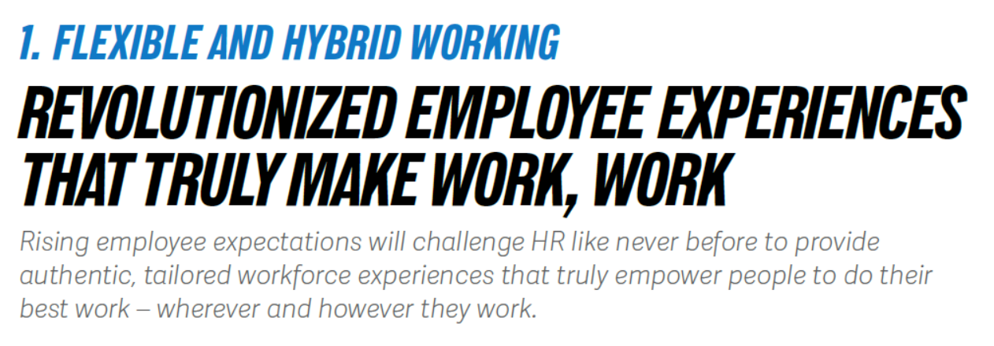


Slide 7
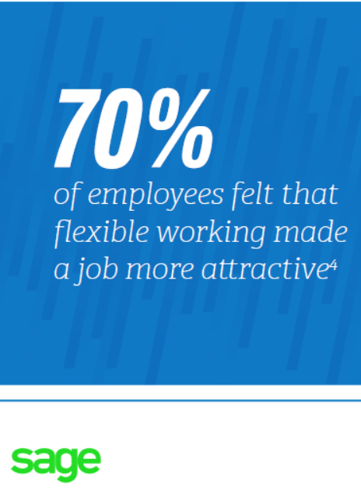

Slide 8
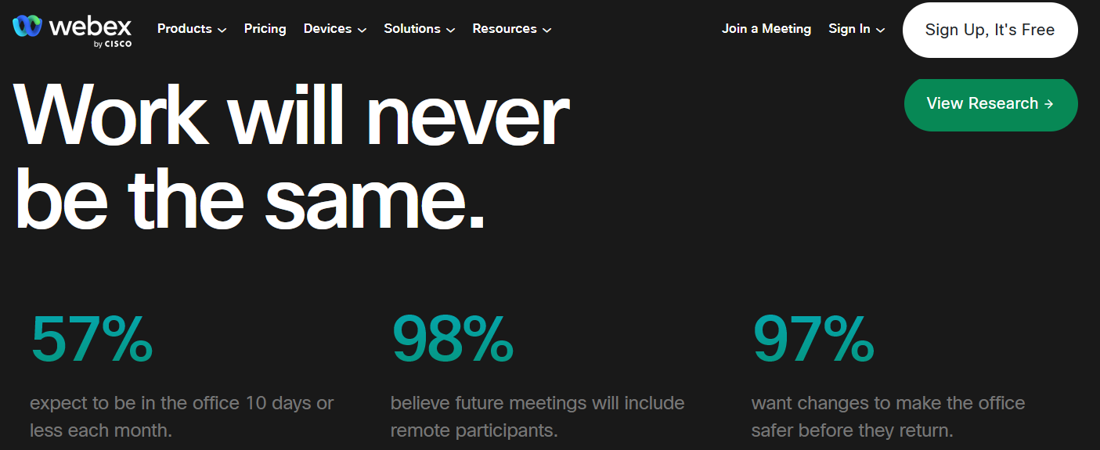

Slide 9
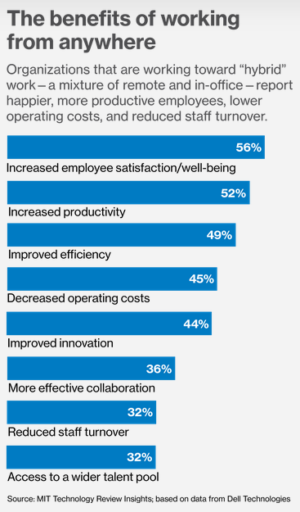



Slide 10
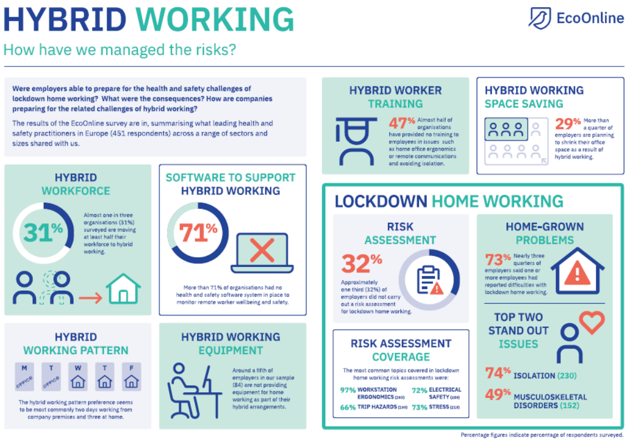

Slide 11

✓29% Shrinking Office Space
✓31% Moving ½: Hybrid
✓32% No Risk Assessment

Slide 12
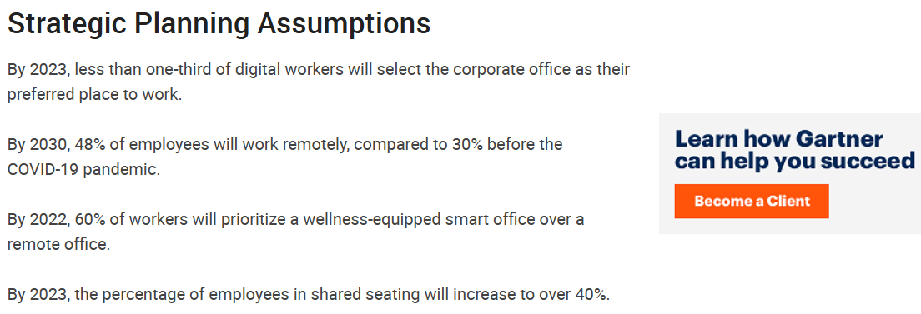


Slide 13
True?

Slide 14
Forever?

Slide 15
It is difficult to make predictions…

Slide 16
It is difficult to make predictions, especially about the future.

Slide 17
Predictions?

Slide 18
Predictions?

Slide 19
Predictions?
Fact Based: Employee Safety

Slide 20
The Hybrid Workplace
Threats, Liabilities, Employer Exposure
Employee Life Safety Issues:
WFH Simultaneous WFO

Slide 21


Slide 22
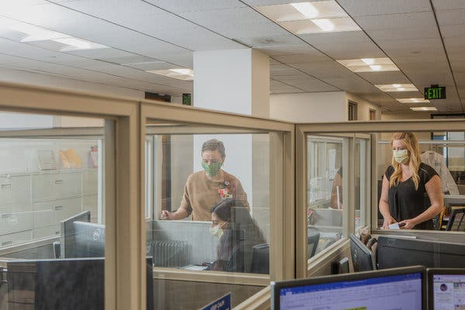

Slide 24
All of 2022?

Slide 25
When Will We Be Back in Our Offices 100%?

Slide 26
When Will We Be Back in Our Offices 100%?
You Are 100% Today!

Slide 27
When Will We Be Back in Our Offices 100%?
You Are 100% Today
Cuz You’re Responsible for Every One of Your Employee’s Safety

Slide 28
When Will We Be Back in Our Offices 100%?
You Are 100% Today
Cuz You’re Responsible for Every One of Your Employee’s Safety at Their Home Office As Well As Your Traditional Office

Slide 29
When Will We Be Back in Our Offices 100%?
You Are 100% Today
Cuz You’re Responsible for Every One of Your Employee’s Safety at Their Home Office As Well As Your Traditional Office
And Always Have Been!

Slide 30
Are You (Employer) Responsible for Employee Safety
Working from Home?

Slide 31
Duty of Care

Slide 32
Affirmative Duty of Care

Slide 33
“Everything
Is Always My Fault”

Slide 34
Duty of
Care
Employee
No Duty

Slide 35
Duty of Care

Slide 36

General Duty Clause
“each employer shall furnish …a place of employment…free from recognized hazards that are causing or are likely to cause death or serious physical harm to employees.”

Slide 37
General Duty Clause
Law
1970
“each employer shall furnish …a place of employment …free from recognized hazards that are causing or are likely to cause death or serious physical harm to employees.”

Slide 38
General Duty Clause
WFH
“each employer shall furnish …a place of employment…free from recognized hazards that are causing or are likely to cause death or serious physical harm to employees.”

Slide 39
Does Not Enforce Their Regs: WFH

Slide 40
Does Not Inspect Your Home Office

Slide 41
Does Not Expect Employer: Inspect WFH

Slide 42
Does Not Enforce Their Regs: WFH But…

Slide 43
You Are Still Responsible for Employee Safety: WFH

Slide 44

WFH

Slide 45
WFH
“Employers are responsible for in-home worksites for hazards caused by materials, equipment, or work processes which the employer provides or requires to be used in an employee's home.”

Slide 46
WFH
“If a complaint or referral is received about hazards at an employee's home-based worksite, the policies and procedures for conducting inspections and responding to complaints as stated…”

Slide 47
WFH
“…in OSHA Instruction CPL 2.103 (the FIRM) and OSHA Instruction CPL 2.115, will be followed, except as modified by this instruction.”

Slide 48
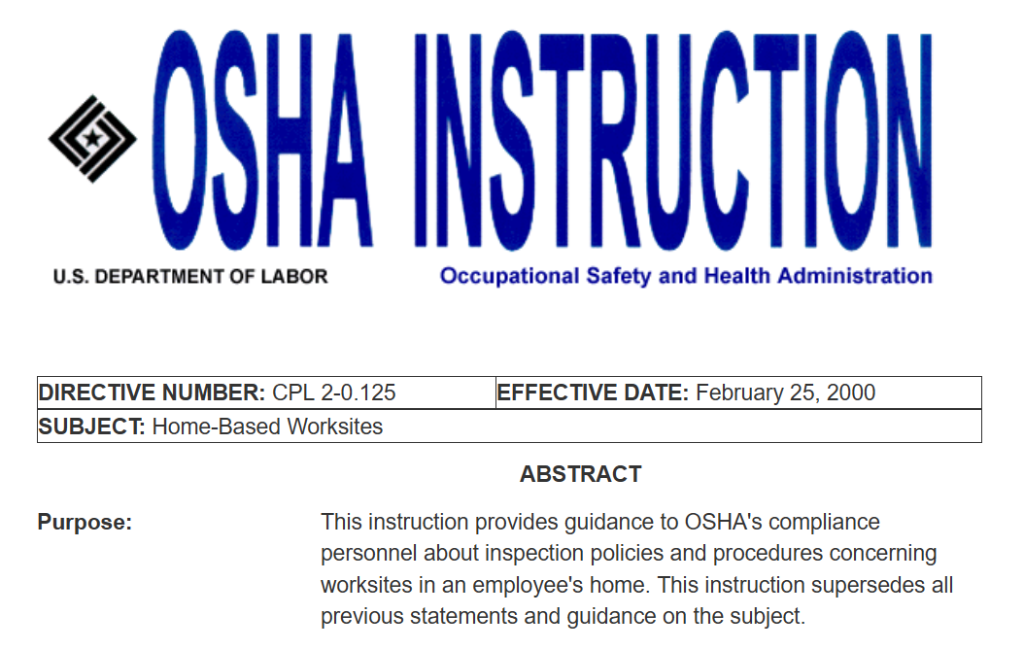

Slide 49
28
Pages

Slide 51
WFH
Matters Only After an Emergency at an Employee’s Home

Slide 52

Work
From
Home

Slide 53
Emergency Action + Fire Prevention Plans:
General Industry
29 CFR 1910.34
29 CFR 1910.38
29 CFR 1910.39

Slide 54
General Industry
Emergency Action Plan
Fire Prevention Plan

Slide 55
Standards

Slide 56
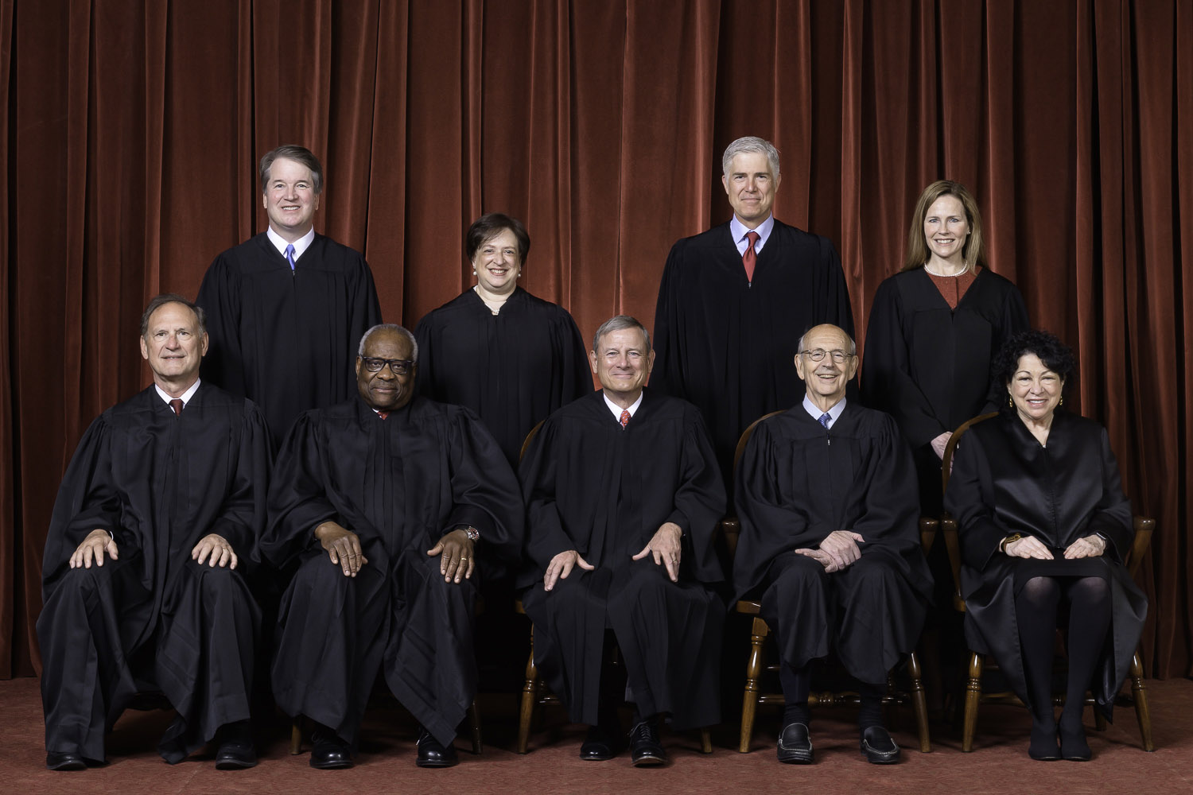

SCOTUS

Slide 57
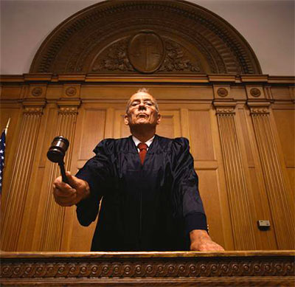
Only Courts Can Set/Adopt the Standards that Juries Use to Judge YOU.
SCOTUS

Slide 58
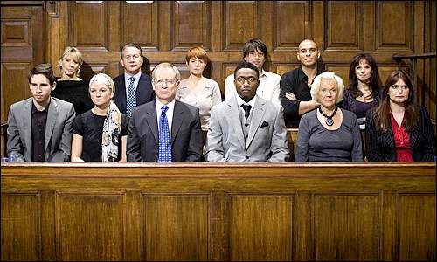
Jury = Employees

Slide 59
Your Employees
Sanctuary
Of
Safety

Slide 60
WFH Injury: Who Pays?

Slide 61
WFH Injury:
Who Pays?
Workers Comp

Slide 62
WFH Injury:
Who Pays?
Workers Comp
Negligence

Slide 63
WFH Injury:
Who Pays?
Workers Comp
Negligence
Failure to
Plan

Slide 64
WFH Injury:
Who Pays?
Workers Comp
Negligence
Failure to
Train

Slide 65


Slide 66
March
2020

Slide 67
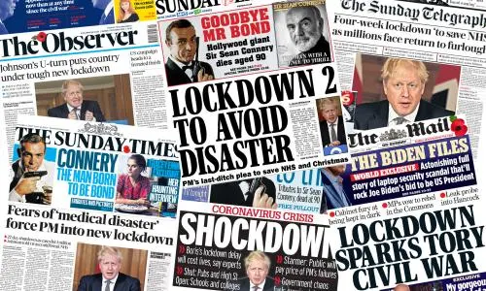

Slide 68
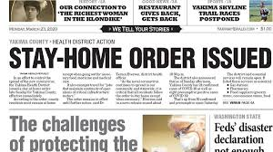

Slide 69
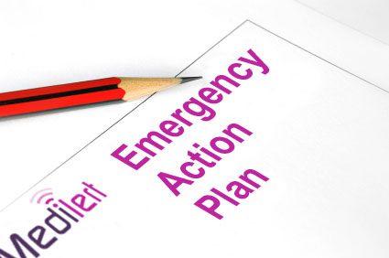
Business
Continuity
Plan + Train
WFH

Slide 70

“They’ll Be Fine”
WFH

Slide 71

WFH
“What Could Go Wrong?”

Slide 72
Do You (Employer) “Own” Your Employees’ Office at Home?

Slide 73
WFH
You Ordered Them: WFH

Slide 74

WFH
You Gave Them a Computer

Slide 75
You Paid: Internet
WFH

Slide 76
WFH
You Expect: Do Their Jobs

Slide 77
WFH
Do This for Weeks, Months, Years

Slide 78

You’ve Created Their Workplace: Home

Slide 79
Do You (Employer) “Own” Your Employees’ Office at Home?

Slide 80
Yes!
Are You (Employer) Responsible for Employee Safety
Working from Home?

Slide 81
✓Operationally
Are You (Employer) Responsible for Employee Safety
Working from Home?

Slide 82
✓Operationally
✓Morally
Are You (Employer) Responsible for Employee Safety
Working from Home?

Slide 83
✓Operationally
✓Morally
✓Legally
Are You (Employer) Responsible for Employee Safety
Working from Home?

Slide 84
WFH
“Send ‘em Home. Simple!”

Slide 85
For Every Complex Problem…

Slide 86
For Every Complex Problem, There’s a Simple Solution

Slide 87
For Every Complex Problem, There’s a Simple Solution
That’s Always Wrong

Slide 88
WFH
Not Simple
Complicated

Slide 89
Fair
Warning

Slide 90
Fair Warning!!!
I Will Be
Candid
★    

Slide 91
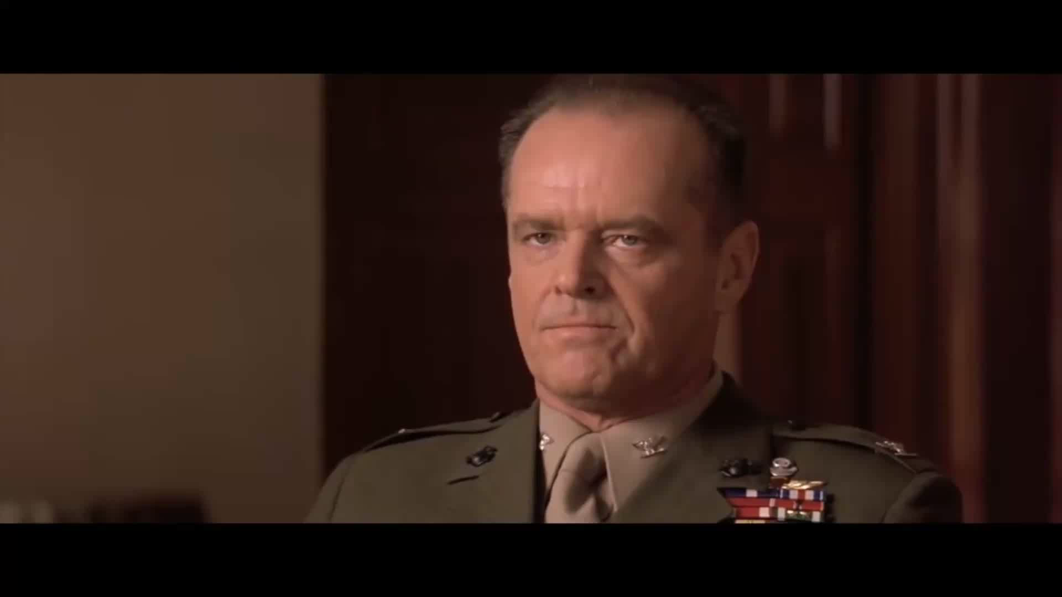

Slide 92
  Bo Mitchell
  911 Consulting
  President
  Police Commissioner (Ret.)

Slide 93


Slide 94
  Bo Mitchell
  911 Consulting
  President
  Police Commissioner (Ret.)
Certified Emergency Manager
CEM, CPP, CHS-V, CBCP, CSI-ML, HSEEP, CNTA, IAC, MOAB, CHSP, CHEP, CSHM, CESCO, CHCM, CFC, CSSM, CSC, CAS, TFCT3, CERT, CHSEMR, CMC

Slide 95
911 Consulting Clients
    GE HQ
    H&R Block HQ
    Hyatt HQ
    MasterCard HQ
    Rolls Royce HQ
    Subway HQ

Slide 96
911 Consulting Clients
26 K-12
20 Camps
5 Colleges + Universities

Slide 97
Speaker
ASSP
NFPA
FEMA
OSHA
SHRM
IFMA

Slide 98
Speaker
ASIS Webinars
Boston
So CT
ConnASIS

Slide 99

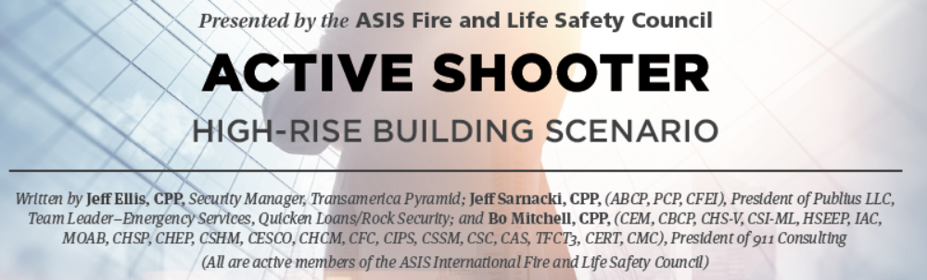
Copyright © 2016 by ASIS International (ASIS)

Slide 100
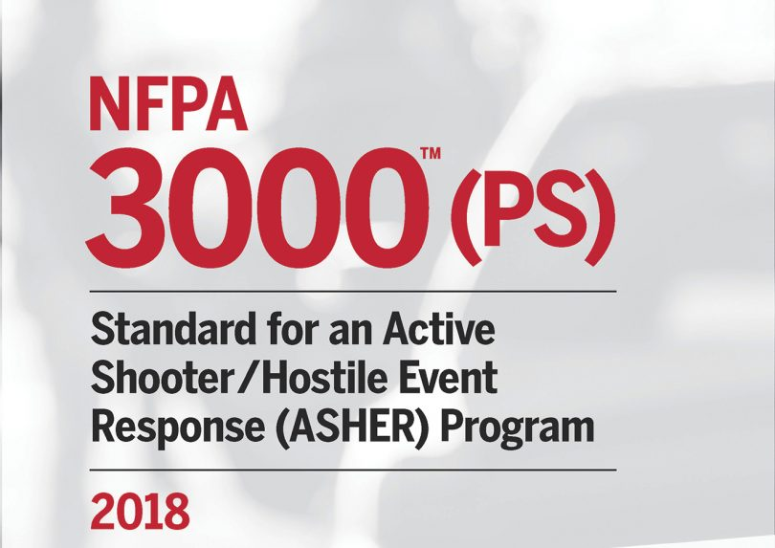

Slide 101
Expert Consultant
Landmark Legal Cases
Expected Settlements:
$1 Billion Each
“Failure to Plan”
“Failure to Train”

Slide 102
The Hybrid Workplace
Threats, Liabilities, Employer Exposure
Employee Life Safety Issues:
WFH Simultaneous WFO

Slide 103
All of 2022?

Slide 104
Duty of Care

Slide 105
General Duty Clause
“each employer shall furnish …a place of employment…free from recognized hazards that are causing or are likely to cause death or serious physical harm to employees.”

Slide 106
When Will We Be Back in Our Offices 100%?

Slide 107
When Will We Be Back in Our Offices 100%?
You Are 100% Today
Cuz You’re Responsible for Every One of Your Employee’s Safety at Their Home Office As Well As Your Traditional Office

Slide 108
General Industry
Emergency Action Plan
Fire Prevention Plan

Slide 109
✓Operationally
✓Morally
✓Legally
Are You (Employer) Responsible for Employee Safety
Working from Home?

Slide 110
WFH Injury:
Who Pays?
Workers Comp
Negligence
Failure to
Plan

Slide 111
WFH Injury:
Who Pays?
Workers Comp
Negligence
Failure to
Train

Slide 113
The Hybrid Workplace
Threats, Liabilities, Employer Exposure
Employee Life Safety Issues:
WFH Simultaneous WFO

Slide 114
Where Do We Start?

Slide 115
All of 2022?

Slide 117


Slide 118
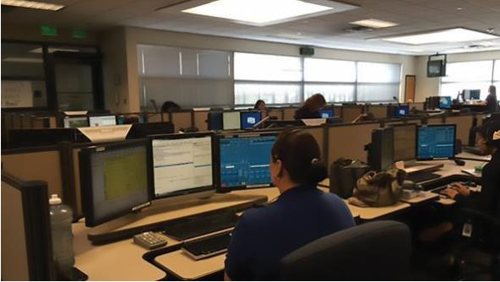

Slide 119
?

Slide 120
OSHA
29 CFR
1910.34

Slide 121
Mandatory
    29 CFR 1910.38/.39
      Emergency Action Plan
      Fire Prevention Plan

Slide 122





Slide 123
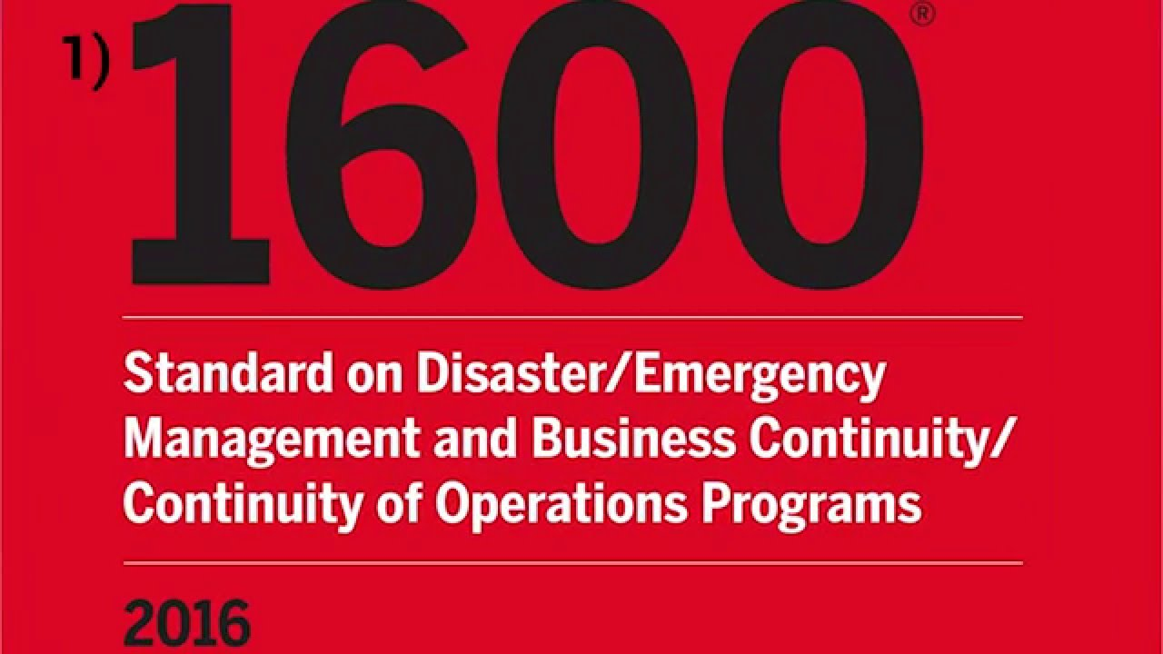

Slide 124
All-Hazards Plan: Shall
Emergency Team
Chain of Command
Visitors
Contractors
Civil Disturbance
Special Needs
Headcounts
Evacuation
In-Building Relo
AAs
Fire
Bomb Threat
Medical Em
Security
Active Shooter
Hostage
Lockout
Suicide
Bullying
Perimeter Access
Security Aft Hours
Chemical Spill: In
Chemical Spill: Out
Shelter in Place
Suspicious Pkg
Suspicious Person
Explosion
Structural Failure
Severe Weather
Elevator Em
Power Outage
Water/Phone Out
Lockdown
Air Quality
Em Shutdown
Earthquake
Flooding
Pipe Burst
CBRNE
Terrorism
Use of FEs
Training
Drills
Exercises
Search-Seizure
Weapons
Evac Maps
Em Contacts
Pandemic: COVID 19
1600

Slide 125
Your Plan???
Fire
Evacuation
Headcounts
Bomb
Chem Spill
Drills
Weather
Sus Pkg
Sus Pers
Pwr Out

Slide 126
All-Hazards Plan: Shall
Emergency Team
Chain of Command
Visitors
Contractors
Civil Disturbance
Special Needs
Headcounts
Evacuation
In-Building Relo
AAs
Fire
Bomb Threat
Medical Em
Security
Active Shooter
Hostage
Lockout
Suicide
Bullying
Perimeter Access
Security Aft Hours
Chemical Spill: In
Chemical Spill: Out
Shelter in Place
Suspicious Pkg
Suspicious Person
Explosion
Structural Failure
Severe Weather
Elevator Em
Power Outage
Water/Phone Out
Lockdown
Air Quality
Em Shutdown
Earthquake
Flooding
Pipe Burst
CBRNE
Terrorism
Use of FEs
Training
Drills
Exercises
Search-Seizure
Weapons
Evac Maps
Em Contacts
1600

Slide 127

Threats
4.1 MM
Workplace Injuries
Annually
DOJ

Slide 128
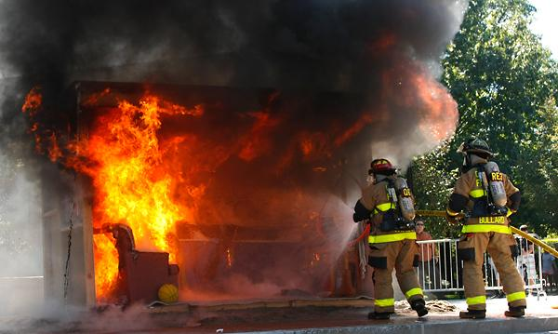
111,500 Structural Fires at Work:

Slide 129
Threats
349,500
HazMat
Spills
NFPA

Slide 130


Threats
HazMat Spills
800,000 Shpmnts Daily
60,000 Spills Yearly
Train-on-Vehicle Collision:
Every 90 minutes
DOT & EPA
U.S. DOT

Slide 131

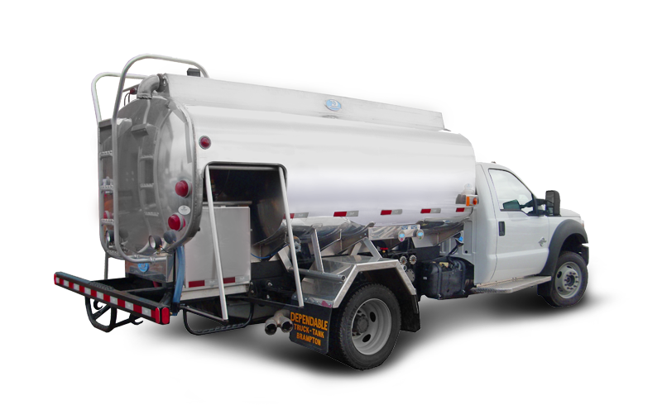
Chlorine

Slide 132
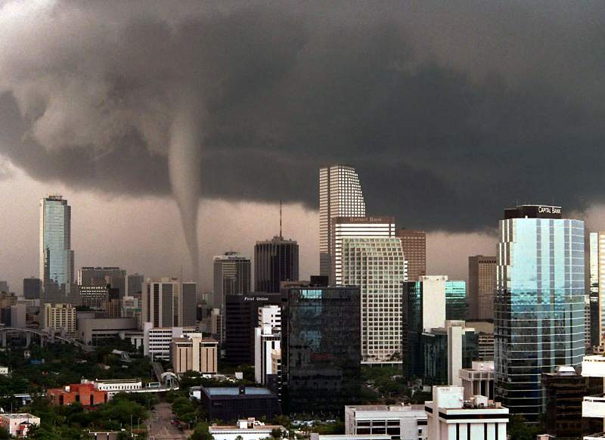

Slide 133

Workplace Bullying

Slide 134
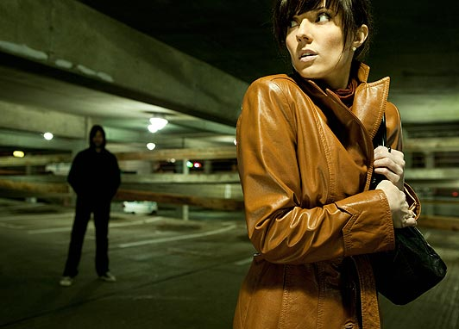
Stalking @ Workplace

Slide 135

Intimate Partner Violence

Slide 136
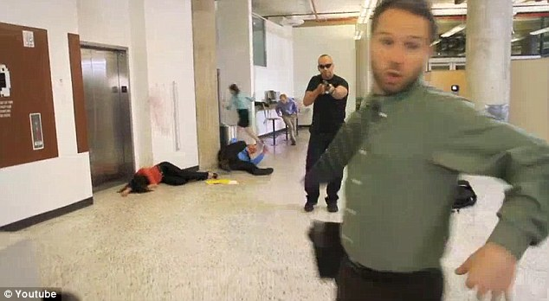

Slide 137
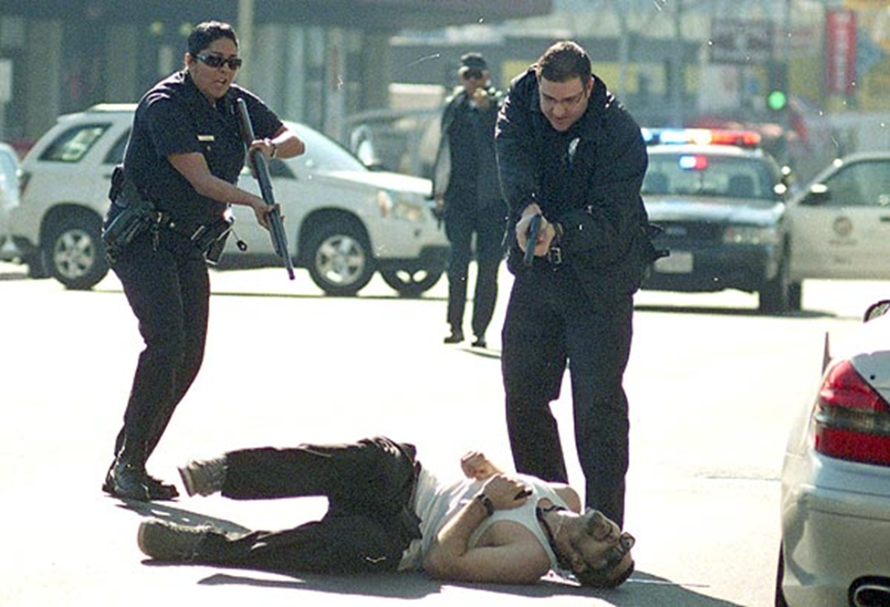

Slide 138


Slide 139
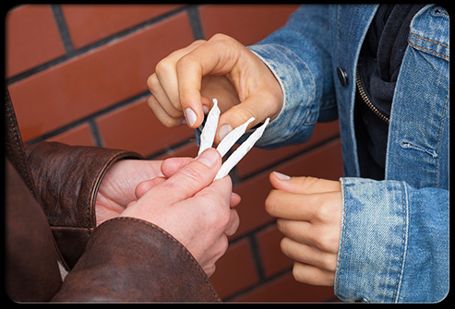

Slide 140


Slide 141


Slide 142
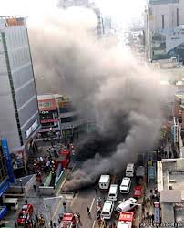

Slide 143


Slide 144
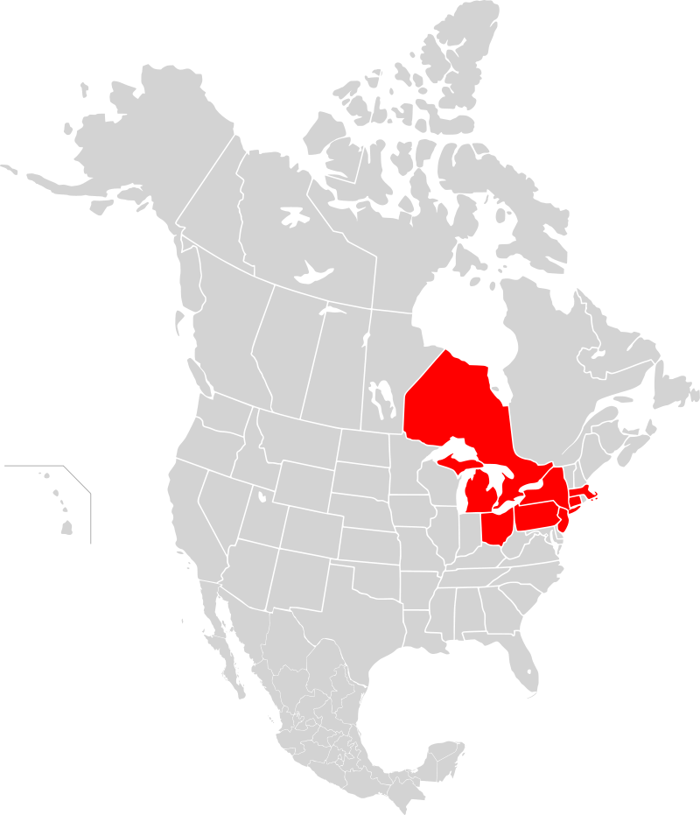
14 Aug 2003

Slide 145
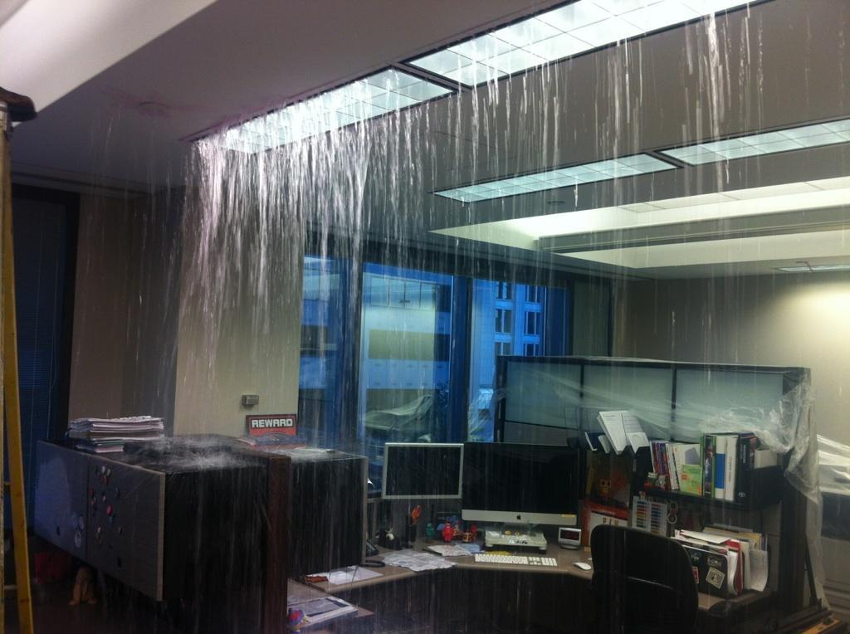

Slide 146
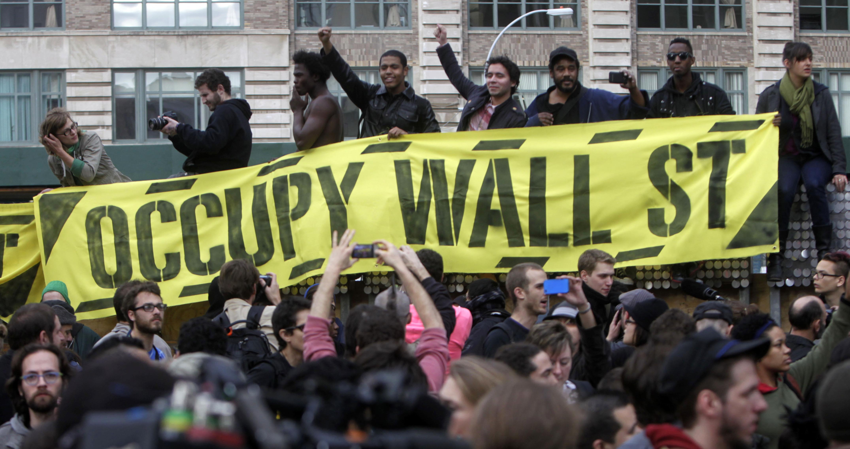
17Sep11-24Mar12

Slide 147
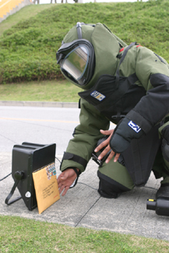

Slide 148
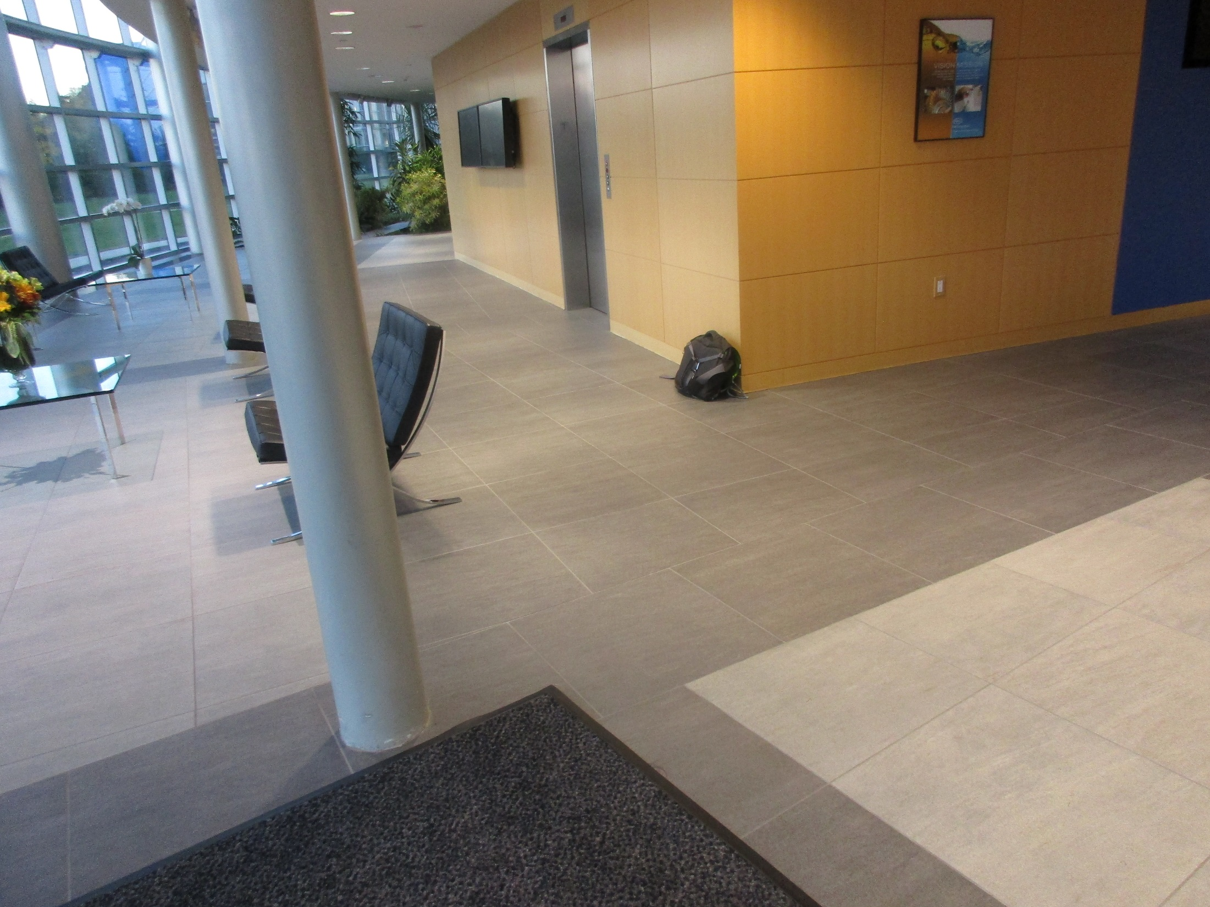

Slide 149
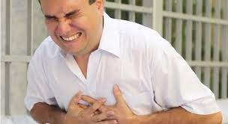

10,000: Work

Slide 150
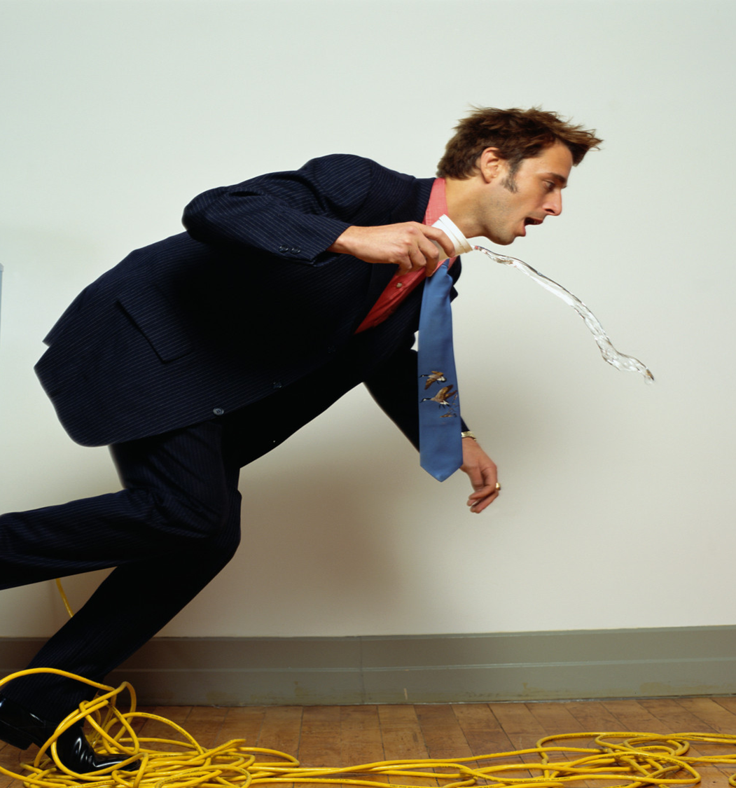
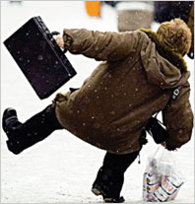

Slide 151
Threats
5,100
Workplace
Deaths
OSHA

Slide 152

Threats
1 Million
Calls to
911 Every Day

Slide 153
?

Slide 154

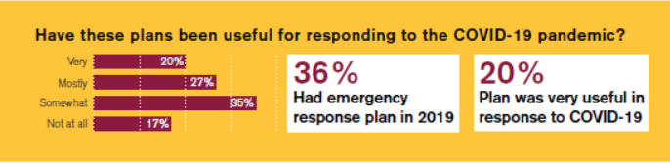
Nov ‘20

Slide 155
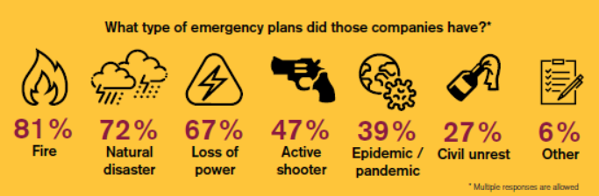
Nov ‘20

Slide 156
Your

Slide 157
1,000+
Emergency Plans Reviewed

Slide 158
Compliant?

Slide 159
Compliant?
1

Slide 160

3
Things Guaranteed
in Life

Slide 161
3 Things in Life Guaranteed
Death

Slide 162
3 Things in Life Guaranteed
Death
Taxes

Slide 163
3 Things in Life Guaranteed
Death
Taxes
You Do Not
Have: EAP Complies with
1600

Slide 164
Landlord?

Slide 165
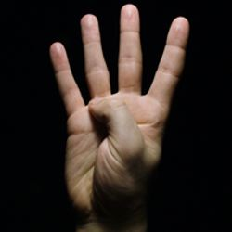
4
Things Guaranteed in Life

Slide 166
4 Things in Life Guaranteed
Death

Slide 167
4 Things in Life Guaranteed
Death
Taxes

Slide 168
4 Things in Life Guaranteed
Death
Taxes
You Do Not
Have: EAP Complies with
1600

Slide 169
4 Things in Life Guaranteed
Death
Taxes
You Don’t Have: EAP
Your Landlord Does
NOT Have: EAP Complies with
1600

Slide 170

4 Things in Life Guaranteed
Death
Taxes
You Don’t Have: EAP
Your Landlord Does
NOT Have
for Himself…
1600

Slide 171
4 Things in Life Guaranteed
Death
Taxes
You Don’t Have: EAP
Your Landlord Does NOT
Have an
Himself…or for You.
1600

Slide 172
Parent
Company:
They Must Have This, Right?

Slide 173

5
Things Guaranteed in Life

Slide 174
5 Things in Life Guaranteed
Death
Taxes
You Don’t Have: EAP
Your Landlord Does NOT Have an
Himself or for You.
5. Your Parent Does
NOT Have: EAP Complies with
1600

Slide 175
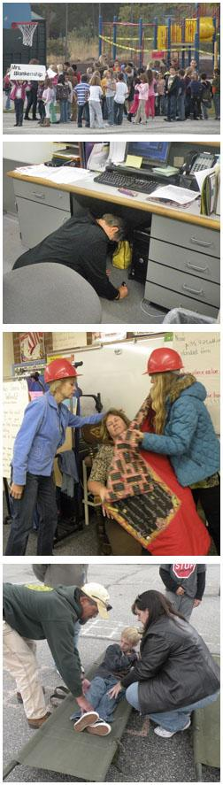
?

Slide 176
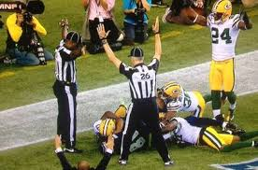
?

Slide 177
?

Slide 178

?

Slide 179
All-Hazards Plan: Shall
Emergency Team
Chain of Command
Visitors
Contractors
Civil Disturbance
Special Needs
Headcounts
Evacuation
In-Building Relo
AAs
Fire
Bomb Threat
Medical Em
Security
Active Shooter
Hostage
Lockout
Suicide
Bullying
Perimeter Access
Security Aft Hours
Chemical Spill: In
Chemical Spill: Out
Shelter in Place
Suspicious Pkg
Suspicious Person
Explosion
Structural Failure
Severe Weather
Elevator Em
Power Outage
Water/Phone Out
Lockdown
Air Quality
Em Shutdown
Earthquake
Flooding
Pipe Burst
CBRNE
Terrorism
Use of FEs
Training
Drills
Exercises
Search-Seizure
Weapons
Evac Maps
Em Contacts
1600

Slide 183
All of 2022?

Slide 184
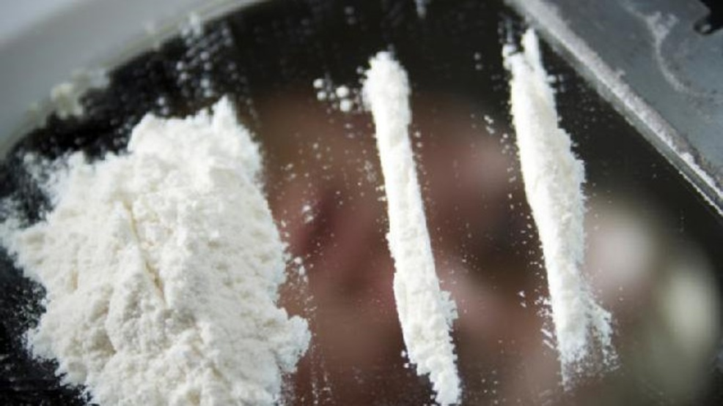

Slide 185
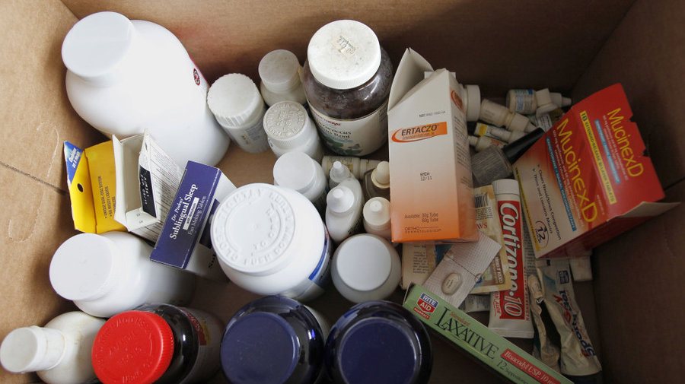

Slide 186


Slide 187



Drug Overdoses
45%
3/14/20-10/12/20 v. Yr. Ago

Slide 188
Drug Overdoses
During
COVID 19
45%
3/14/20-10/12/20 v. Yr. Ago

Slide 189
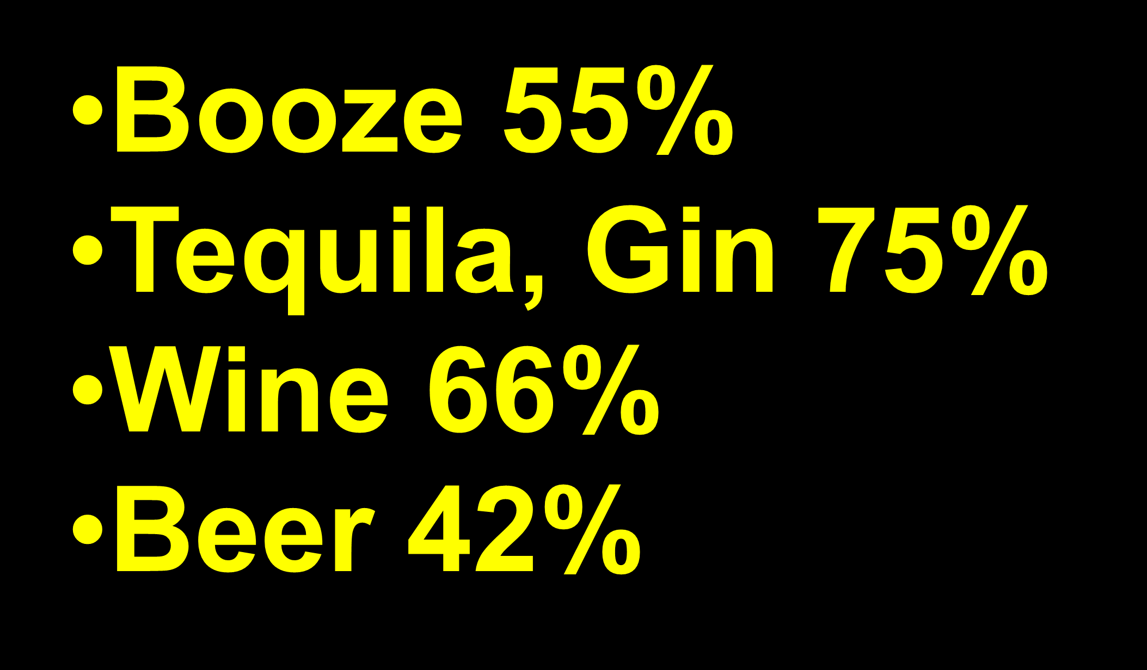


Slide 190
During
COVID 19

Slide 191


34%
.
U.S.
DivorceFilings

Slide 192
DivorceFilings
During
COVID 19
U.S.
+30%
.
Divorce
Filings

Slide 193
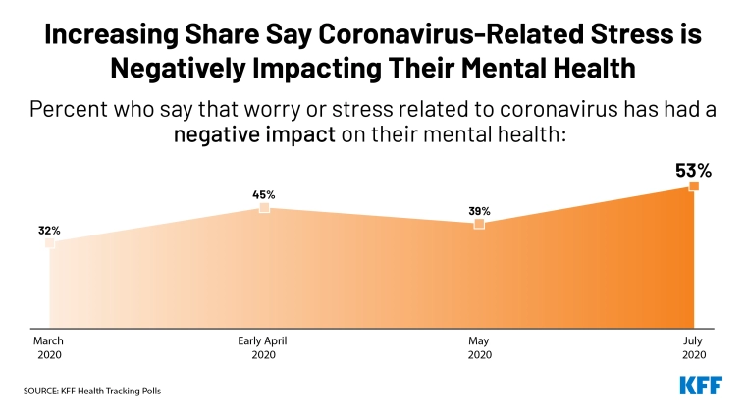


Slide 194
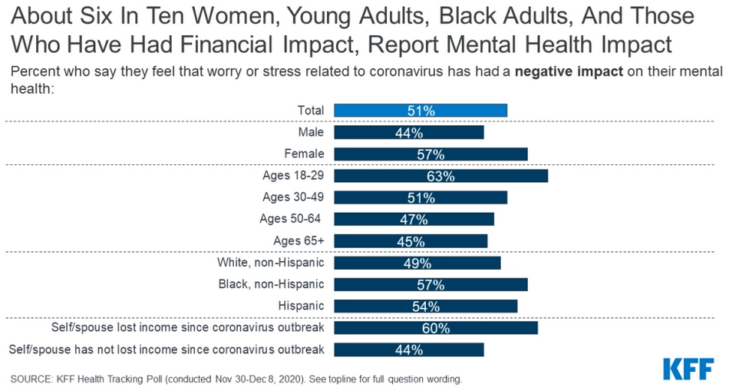

Slide 195
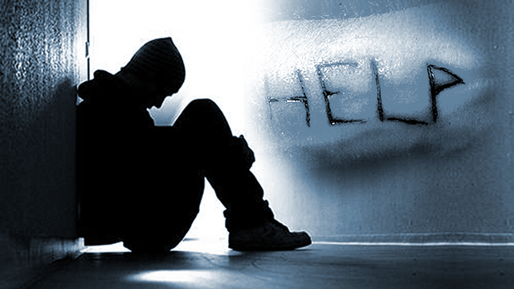

Slide 196


COD: U.S. 2020
Auto Deaths: 38,680
Gun Deaths: 19,411

Slide 197

COD: U.S. 2020
Auto Deaths: 38,680
Gun Deaths: 19,411
Suicides:
47,511

Slide 198
All of 2022?

Slide 199

Calls: Suicide Lifeline
Reports Suicides
27%
CY 2020 v.
CY 2019

Slide 200
Reported Feeling Anxious or Depressed
Reports Suicides
3X
CY 2020 v.
CY 2019

Slide 201
Reported Feeling Anxious or Depressed
During
COVID 19
Reports Suicides
3X
CY 2020 v.
CY 2019

Slide 202
Suicides: U.S. 2018
Highest in middle-aged white men.
Average: 132 suicides per day.
White males = 69.67% of suicides
Firearms = 50.57% of all suicide deaths.

Slide 203

8 of 10 Corp Executives
have experienced poor mental health during the coronavirus crisis, prompting a number of them to re-evaluate and improve
work-life balance.

Slide 204
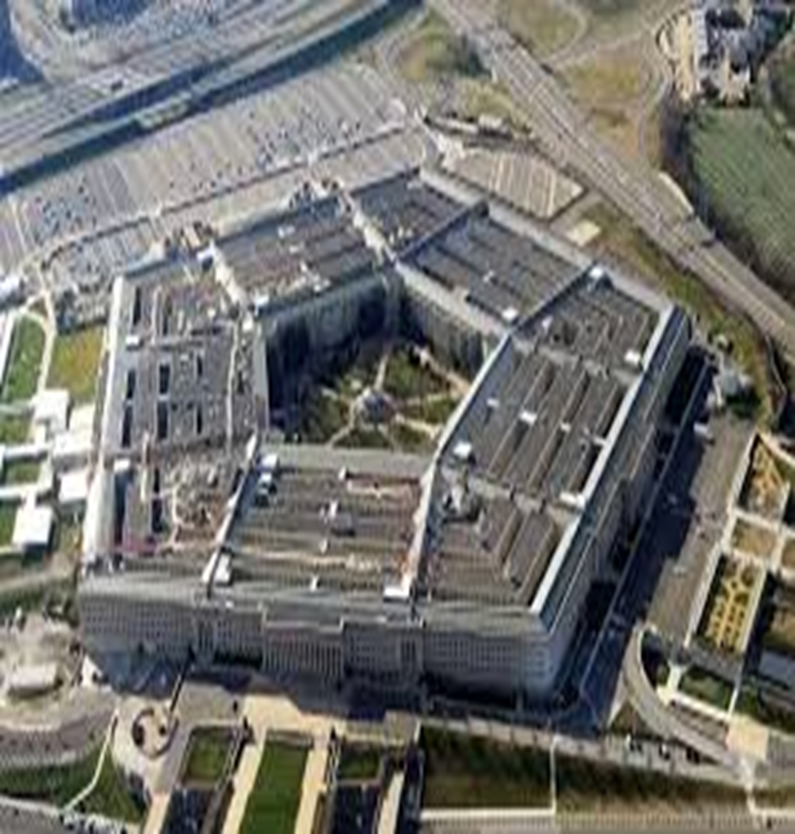
Reports Suicides
30%
U.S. Military Reports Suicides

Slide 205
During
COVID 19
Reports Suicides
30%
U.S. Military Reports Suicides

Slide 206
Considered Suicide
During COVID19
10% All US Adults
30% w/o HS Diploma
13% w HS Diploma
44% of PTSD
30% Unpaid Caregivers

Slide 207

Overall Stress + Depression
53% + emotionally exhausted
53% + feeling of sadness in day-to-day life
50% + irritable
42% + confused
38% + insomnia
32% + anger
24% + feelings of guilt

Slide 208

Overall Stress + Depression
Per-day # of anxiety screens +535% Aug v. Jan
Per-day # of depression screens +709%
Aug v. Jan

Slide 209


988
National Suicide
Prevention Lifeline
Authorized
16 July 2020

Slide 210
Warning Signs
Employees Who May Become Suicidal
Excessive sadness or moodiness
Sudden calmness
Withdrawal
Changes in personality and/or appearance
Dangerous or self-harmful behavior
Recent trauma or life crisis
Making preparations
Threatening suicide

Slide 211
COD: U.S. 2020-2021
Auto Deaths: 38,680
Gun Deaths: 19,411
Suicides 47,511
Overdoses:
100,000+

Slide 212
All of 2022?

Slide 213
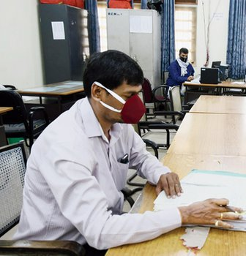
Stress
Work
Family/School
Commuting
4th Wave
Another Quarantine
Family Income

Slide 214
Yellow Flags Employees Who May Become Violent
Fascination w weapons/incidents of violence
General narcissistic attitude
Disruptive outbursts or temper flare-ups disproportional to source of agitation
Consistent attempts to argue against co-workers
Tendency to interpret daily events in a morbid or pernicious way
Consistent display of "victim-syndrome"
Controlling or demanding personality
General tendency to make
co-workers uncomfortable
Proponent of general and "inter-office" conspiracy theories
Multiple gun ownership
Consistent complaints, negative comments, or consistently filing grievances
Persistent, inappropriate anger
Affiliation with fringe, anti-government, or racist organizations
Indications of drug or alcohol abuse

Slide 215
Yellow Flags Employees
Who May Become Violent
Train
Your
Employees
Fascination w weapons/incidents of violence
General narcissistic attitude
Disruptive outbursts or temper flare-ups disproportional to source of agitation
Consistent attempts to argue against co-workers
Tendency to interpret daily events in a morbid or pernicious way
Consistent display of "victim-syndrome"
Controlling or demanding personality
General tendency to make
co-workers uncomfortable
Proponent of general and "inter-office" conspiracy theories
Multiple gun ownership
Consistent complaints, negative comments, or consistently filing grievances
Persistent, inappropriate anger
Affiliation with fringe, anti-government, or racist organizations
Indications of drug or alcohol abuse

Slide 216
Red Flags Employees Who May Become Violent
Suffers what the individual considers a profound, public humiliation
Passed over for promotion
Individual makes critical mistake that negatively affects the company
Individual is publicly reprimanded
Individual is teased or otherwise harassed
Individual is fired,
laid-off, "downsized"
Personal life trauma resulting in a feeling of helplessness
Divorce, separation
Death of spouse, family member
Dramatic increase in anxiety, anger, depression (swift, observable mood swing)

Slide 217
Red Flags Employees Who
May Become Violent
Train
Your
Employees
Suffers what the individual considers a profound, public humiliation
Passed over for promotion
Individual makes critical mistake that negatively affects the company
Individual is publicly reprimanded
Individual is teased or otherwise harassed
Individual is fired,
laid-off, "downsized"
Personal life trauma resulting in a feeling of helplessness
Divorce, separation
Death of spouse, family member
Dramatic increase in anxiety, anger, depression (swift, observable mood swing)

Slide 218
Warning Signs
Employees Who May Become Suicidal
Excessive sadness or moodiness
Sudden calmness
Withdrawal
Changes in personality and/or appearance
Dangerous or self-harmful behavior
Recent trauma or life crisis
Making preparations
Threatening suicide

Slide 219
Warning Signs
Employees Who May
Become Suicidal
Train
Your
Employees
Excessive sadness or moodiness
Sudden calmness
Withdrawal
Changes in personality and/or appearance
Dangerous or self-harmful behavior
Recent trauma or life crisis
Making preparations
Threatening suicide

Slide 220


Slide 221
?

Slide 222
All of 2022?

Slide 224
WFH

Slide 226
354,400 Fires at Home

Slide 227
Home Fires: 2,620 Dead

Slide 228
Home Fires:
79% All Deaths

Slide 229
Home Fires:
79% All Deaths
No
Sprinklers

Slide 230
Cooking
Heating
Electrical
Smoking

Slide 231
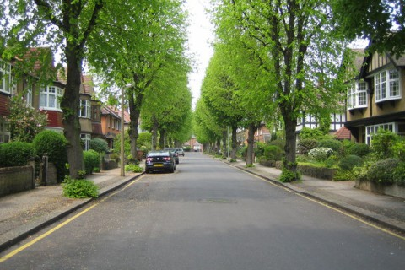
Chlorine

Slide 233
Workplace Bullying

Slide 234
Stalking @ Workplace

Slide 235
Intimate Partner Violence

Slide 240
14 Aug 2003

Slide 242
1.5 Million

Slide 244
WFH
Not Simple
Complicated

Slide 245
WFH
Answer to Complicated

Slide 246
WFH Safety
✓Plan
✓Train

Slide 247
WFH Safety
✓Plan
Checklist

Slide 248
354,400 Fires at Home

Slide 249
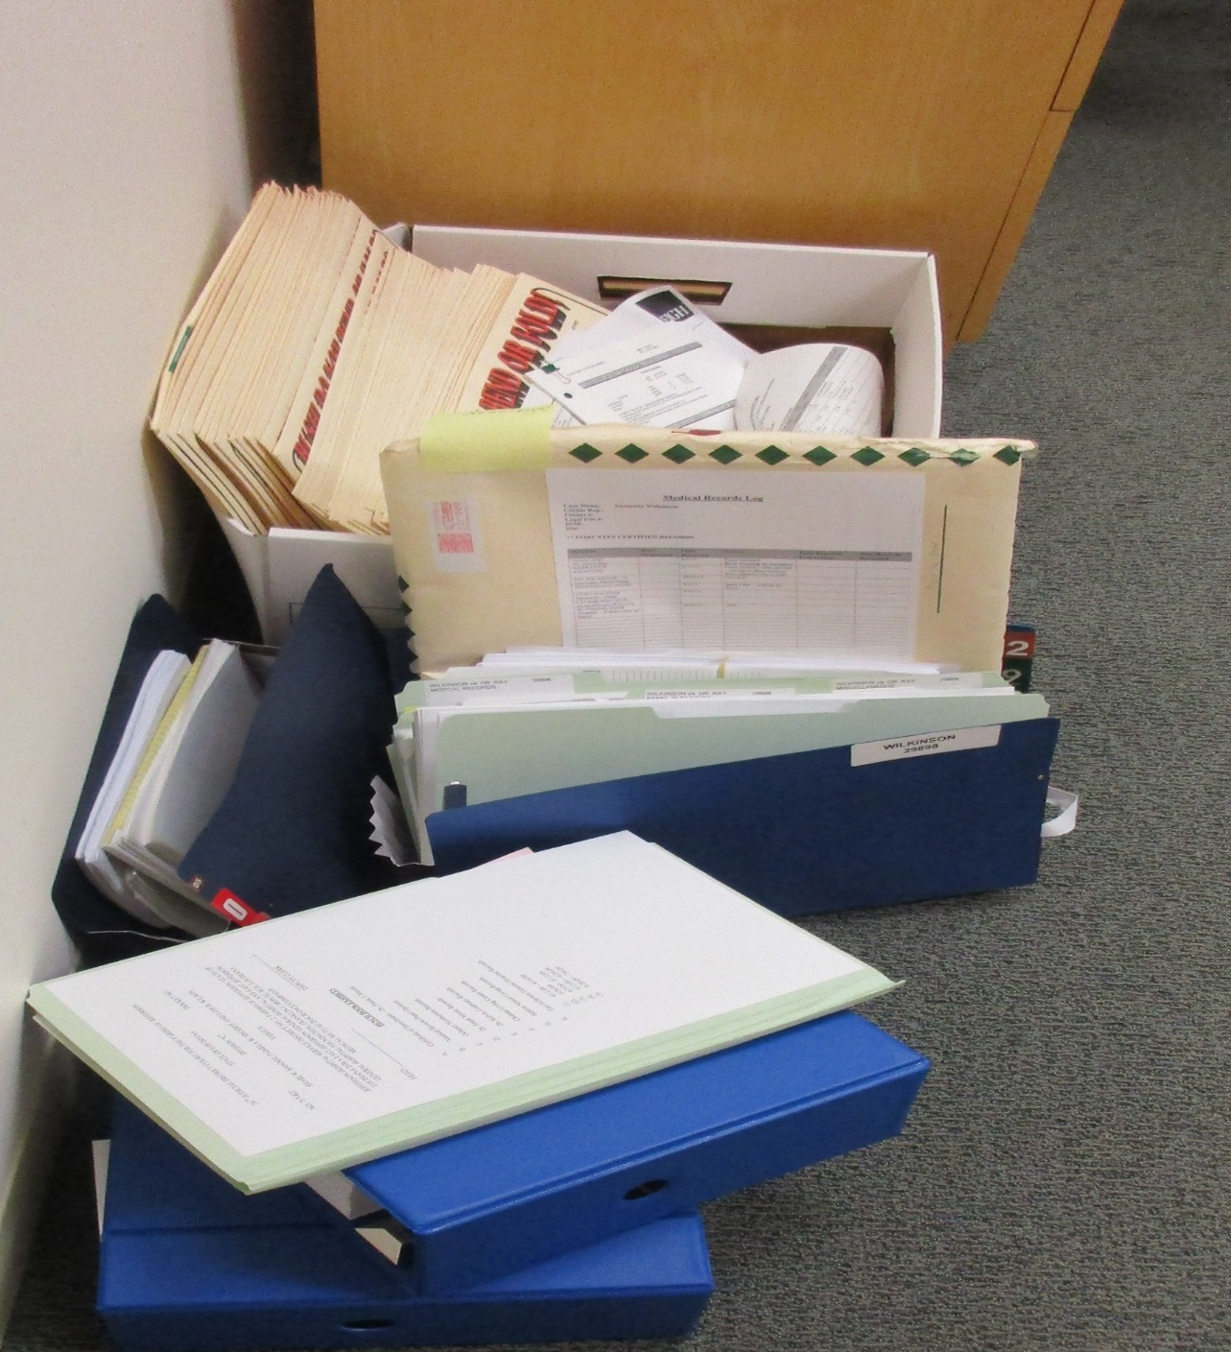


Slide 250


Slide 251


Slide 252


Slide 253


Slide 254


Slide 255


Slide 256

WFH
Assess
Home
Safety

Slide 257
Why We Plan & Train
Great plans are a smart thing…

Slide 258
Why We Plan & Train
Great plans are a smart thing…
Training is
everything

Slide 259
Training: The Law
Mandatory
Train All Employees
In Classroom
Annually & At Hire
“Qualified” Trainer
(by Experience, Training)

Slide 260


Slide 261

On-Screen Training Can Supplement

Slide 262
On-Screen Training Can NEVER Substitute

Slide 263

OK
During
COVID 19
On-Screen Training Can Supplement

Slide 264
Employees
Hate This
Stuff!

Slide 265

National Research
85%
Safety:
MOST Important
Issue at Work

Slide 266
National Research
85%
Safety: MOST Important Issue at Work
More Imp than:
        Wages
        Leave
        Sick Days
        Overtime
        Union

Slide 267
Training
Guarantee

Slide 268
Training Promise
You Give Me
Your Emps
3 hrs Annually

Slide 269
Training Promise
I’ll Give You Back Your Emps Confident They Can Respond to Any Emergency

Slide 270
Training
Trained 41,000 Employees

Slide 271
Training
Trained 41,000 Employees
98.5%
Confident

Slide 272
98.5% Confident
Made It All About THEM

Slide 273
98.5% Confident
Took “Scary” out of Discussion

Slide 274
98.5% Confident
Made Everyone Comfortable

Slide 275
98.5% Confident
Empowered All

Slide 276
Trust
in You as the Boss

Slide 277
84% of
Bosses Feel
They’re Doing a Great Job During Covid-19
15Five Survey

Slide 278
86% of
U.S. Remote workers say they don’t trust their CEOs and Sr. Mgrs. to safely lead them back to work
Honeywell

Slide 279
29% of workers would look for a new job rather than return to a site that has not implemented necessary safety measures
Edelman Trust Barometer Special Report:
Workplace Trust and the Coronavirus

Slide 280
98.5% Confident
How to Prove
TRUST ?

Slide 281
98.5% Confident
Send Emails????

Slide 282
98.5% Confident
Don’t Tell Them

Slide 283
98.5% Confident
Show
Them

Slide 284
Denial

Slide 285
HDWSI
How Do We Sell It?

Slide 286
HDWSI
Planning
Training
Drills
Exercises

Slide 287
Protecting Your:
People
Property
Productivity
Posterior

Slide 288
Getting It Done Is Tough!

Slide 289

Scariest Word

Slide 290
NOT:
“Cost” or
“Price” or
“Budget” or
“Headcount”

Slide 291
Change!

Slide 292
Change Occurs Because of

Slide 293

Blunt Force Trauma from the Outside

Slide 294

…Never by Inspired Leadership from the Inside

Slide 296
HDWSI
About
Denial

Slide 297


Slide 298
“Jaws”: Cultural Earthquake
“Won’t Close the Beaches” =
$$$

Slide 299
“Jaws”: Cultural Earthquake
“Won’t Close the Beaches” = $$$
“Can’t Hire More Lifeguards” = $$$

Slide 300
“Jaws”: Cultural Earthquake
“Won’t Close the Beaches” = $$$
“Can’t Hire More Lifeguards” =$$$
“I’ve Never Seen this Shark”

Slide 301
“Jaws”: Cultural Earthquake
“Won’t Close the Beaches” = $$$
“Can’t Hire More Lifeguards” =$$$
“I’ve Never Seen this Shark”
“Are You Sure We Have a Problem?”

Slide 302
We Never See the Monster in the 1st 60 Minutes
★    

Slide 303


Slide 304
“We Need a Bigger Boat!”

Slide 305


Slide 306


Slide 307
How Do
You Get Emps Trust You?

Slide 308
Your

Slide 309
Revise
All of it
Your

Slide 310

Recon-figure
Your Space?

Slide 311
Recon-figure
Your Space?
Trigger
For
Training

Slide 312
Recon-figure
Your Space?
Required
By Law
Training

Slide 313
Train
All Emps
Your

Slide 314
Training Builds Trust
1. Train Remotely
B4 RTW: COVID-19

Slide 315
WFH ✓List
Audit/Compliance
Present Checklist

Slide 316
WFH ✓List
Audit/Compliance
Present Checklist
Train Checklist

Slide 317
WFH ✓List
Audit/Compliance
Present Checklist
Train Checklist
Employee Signs Checklist

Slide 318
WFH ✓List
Audit/Compliance
Present Checklist
Train Checklist
Employee Signs Checklist
Employee Can Access You for Help

Slide 319
WFH Safety
✓Plan: Checklist
✓Train

Slide 321
Training Builds Trust
1. Train Remotely
B4 RTW: COVID-19
2.Train On Site: All Hazards

Slide 322

Confidence
Trust
Peace of Mind
Training
Reliability
Compliance

Slide 323

Training Builds Trust

Slide 324
Help for You
Right Now

Slide 325
Help For You Now
A Copy of This Presentation

Slide 326
Help For You Now
A Copy of This Presentation
WFH Safety Checklist

Slide 327
Help For You Now
A Copy of This Presentation
WFH Safety Checklist
RTW Safety Checklist

Slide 328
Help For You Now
A Copy of This Presentation
WFH Safety Checklist
RTW Safety Checklist
10 Commandments of Emergency Planning for Employers

Slide 329
Help For You Now
A Copy of This Presentation
WFH Safety Checklist
RTW Safety Checklist
10 Commandments of Emergency Planning for Employers
10 Commandments of Employee Training for Your Workplace


Slide 330


Slide 331
Questions?
Bo Mitchell@911Consulting.net
203.563.9999

